Slide 1
Twin Harbors Sediment Intro
A joint project of Global Ocean Health/National Fisheries Conservation Center and Stantec
MRC Summit: October 16th 2020, Julia Sanders

Slide 2
In the beginning….
Around the early 1990s oyster farmers in Grays Harbor started noticing major impacts from sediment smothering their oysters.
Crops are being lost to the tune of collective millions over time, and DNR and owners are losing acreage and lease income
A USACE deep dredge project occurred around the same time. This wasn’t believed to be coincidence
Whitcomb Flats in particular was migrating quickly, and growers started to raise concerns about prime tidelands vanishing, as well as a Natural Area Preserve and Caspian tern breeding ground

Slide 3
2003 Report on the Dynamics of Whitcomb Flats
By Pacific International Engineering on behalf of the Port of Grays Harbor and in response to increasing concerns from oyster growers and DNR.
It was a comprehensive look at dredging and morphological changes in Grays Harbor from 1896-2003.
Whitcomb Flats emphasized the dramatic changes occurring in some of the most valued oysterlands.

Slide 4
“The net distance between the centroids for 1967 and 2001 is 1041 to 1135 m, indicating an average net rate of migration of 30 to 32 m per year over 35 years.”

Slide 5
The Corps originally admitted fault:

Slide 6
Negotiations between DNR and USACE for mitigation funding fell apart ca. 2006
While originally the Corps admitted responsibility for affecting the ecosystem and the hydrodynamics, and had gone as far as discussing specific mitigation options with DNR, by 2006 discussions stopped
Options considered at the time included loose or bagged oyster shell, pilings, geotubes, and reef balls
The Corps no longer admits any responsibility for geomorphic changes in the harbor and are not a viable source of funding.

Slide 7
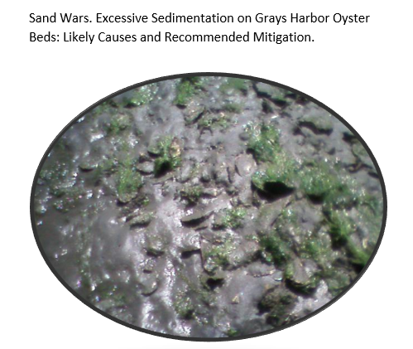
In 2015 National Fisheries Conservation Center was hired by the GHCD to write a report on sedimentation and mitigation
With support from GeoEngineers, we interviewed the growers of Grays Harbor, conducted a literature review, investigated mitigation options, corresponded with the agencies involved and reviewed historical documents and videos
A paper and a lengthy appendice resulted, with the recommendation that the required next step would be hydrodynamic modeling (not an inexpensive prospect)

Slide 8
Meanwhile oyster farmers continued to suffer losses
From the 2015 report “Sand Wars”:
“This year [2015] we’ve lost beds 4 and 7, we had set the seed in 2011, and spread the oysters in 2012. We expected to harvest this fall. Total expected income lost is $210,000. These were nearly full-grown oysters, that we went to check on after high swells, and they’d been buried to the lips in sand. Despite desperately attempting to harrow the sand, we lost both beds.”
Another prominent grower in Grays Harbor lost 46 acres in Central Bay due to sand movement that he estimates costs the company $441,600 annually in revenue. He also states that the approximately 150 acres he operates around Whitcomb Flats in South Bay are threatened by sediment transport. Without mitigation, these sedimentation issues could cost the company $1.4 million annually. He further states that, “There’s a lot more sediment coming in the North Bay too – we had deep sea beds there with a shelly bottom, and now in the past 10-15 years it’s covered in sediment. We’re almost ready to abandon them, but need the room. This is likely the last year we’ll risk using it, and as it is we’re transporting large oysters there for final growth, because young oysters would be smothered by the sand”

Slide 9
In 2019 the CD received took bids for modeling of both estuaries, that would reveal the best mitigation solutions
It took time, but thanks to continued voices of growers, the CD, the county commissioners and other local legislators, funding for the recommended modeling was allocated and the Twin Harbors Sediment Project was born.
Beginning in Jan 2020 data from USACE, USGS, satellites, academic papers, growers, and other sources has been compiled into a sophisticated model revealing the fate of dredged material.
By year’s end we’ll identify the best possible mitigation strategies, from the farm to estuary scale.

Slide 10
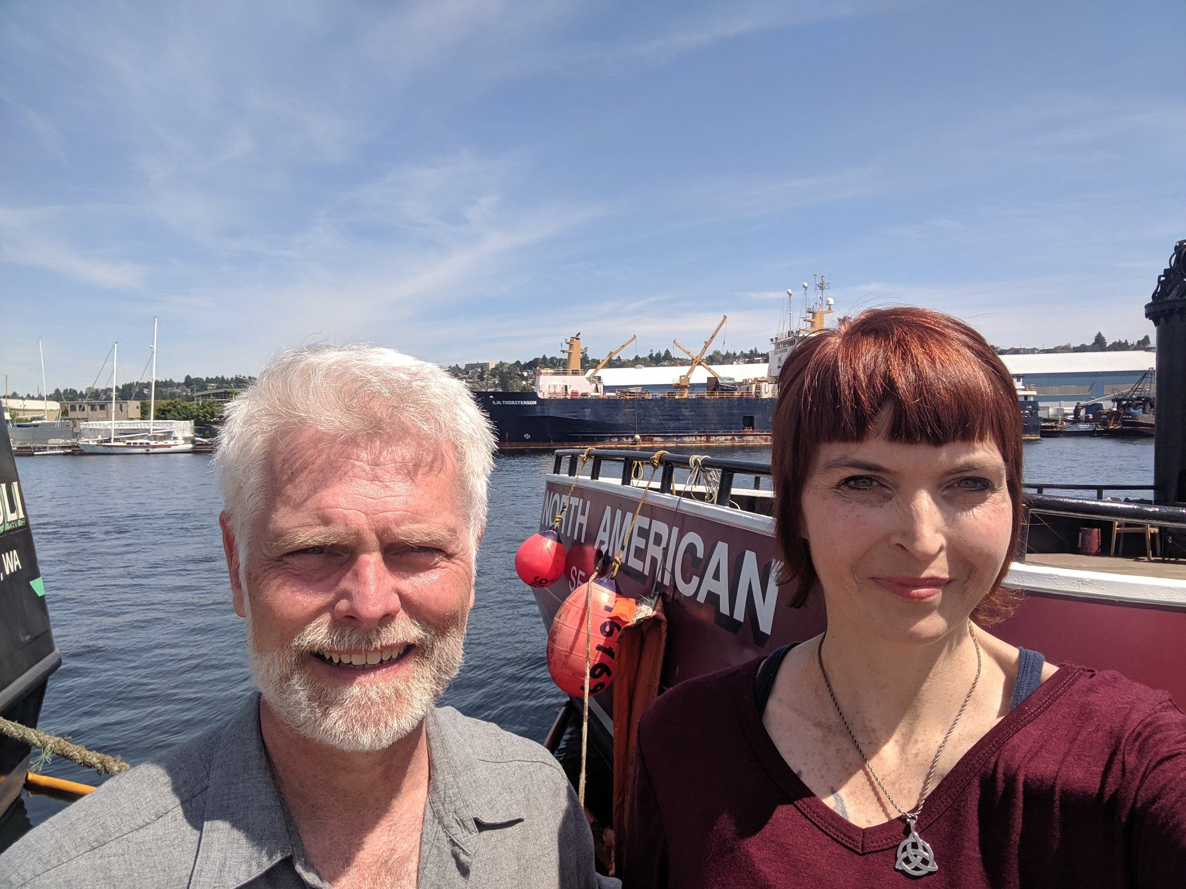
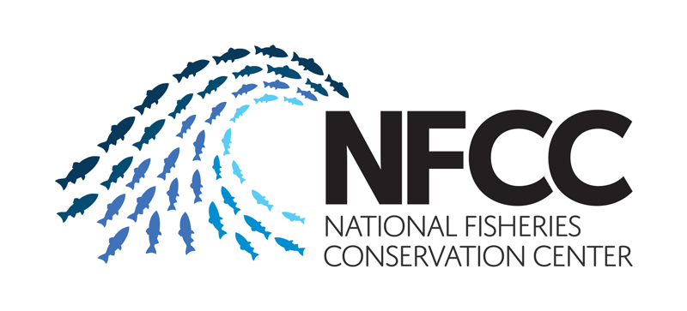
And the next presenter will tell you all about that work!
Any questions in the meantime?
Always feel free to reach out to me at julia@globaloceanhealth.org for more info about this project

