Slide 1
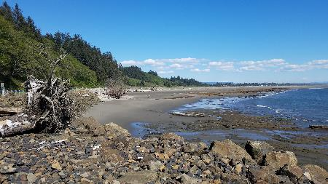



Graveyard Spit Restoration and Resilience Project
Presented by:
Henry Bell, Washington State Department of Ecology
Dave Michalsen, U.S. Army Corps of Engineers
Garret Jackson, Washington State Department of Transportation
Chelsey Martin, Washington State Department of Transportation

Slide 2
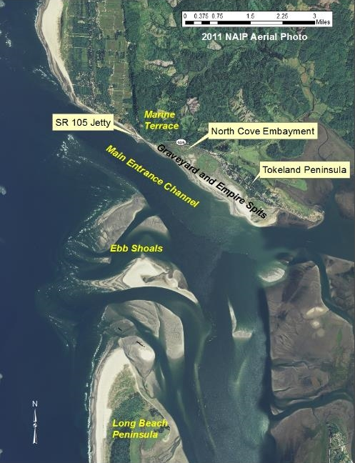
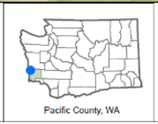
This project will address…
North Cove
Problem:
  High energy shoreline area
  Rapid shoreline erosion from Pacific Ocean tidal action
Issue:
  Compromised State Route (SR) 105 roadway
  Loss of wetland and critical areas
Regional Priority: High
  Only access that connects the Shoalwater Bay Reservation and Tokeland to the south & Grayland, Cranberry Farms to the north
Pacific Ocean
Willapa Bay

Slide 3
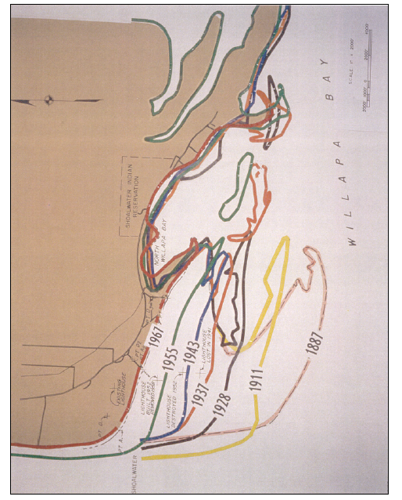
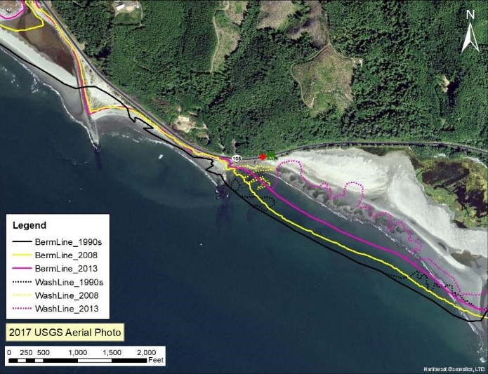
A long history of shoreline retreat

Slide 4
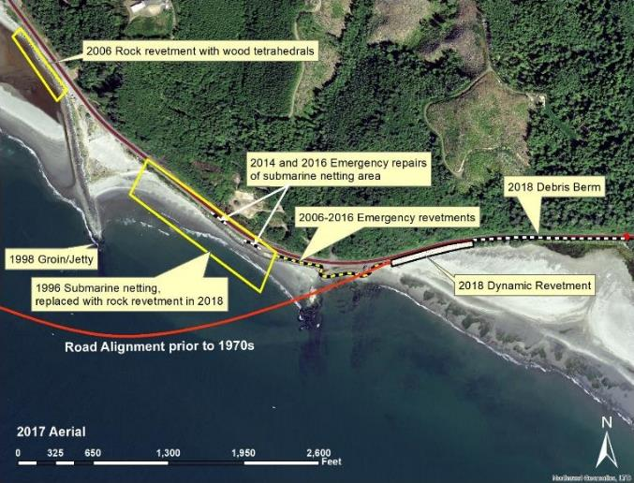
WSDOT Background
Decades of projects
On-going Maintenance

Slide 5
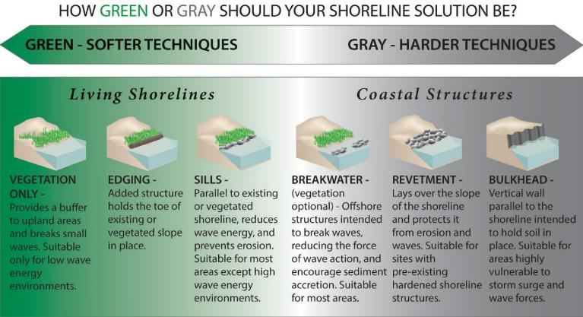
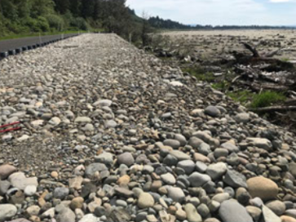
Strategy to Address the Problem
Dynamic
Revetments

Slide 6
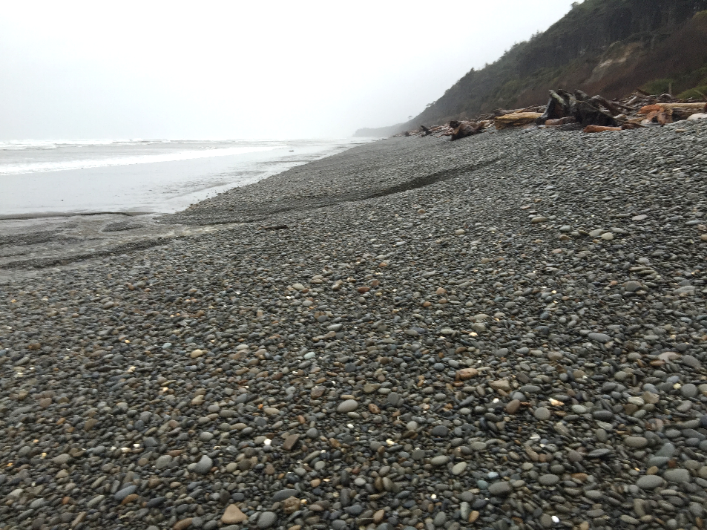
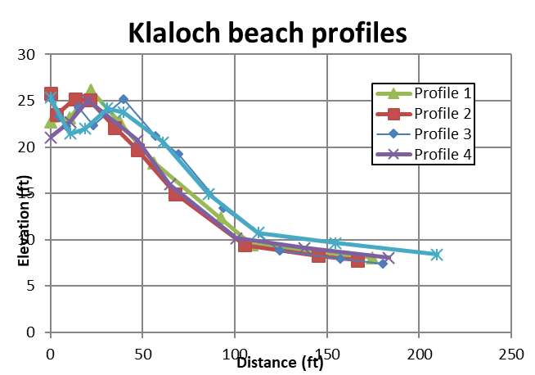
Using natural analog beach

Slide 7
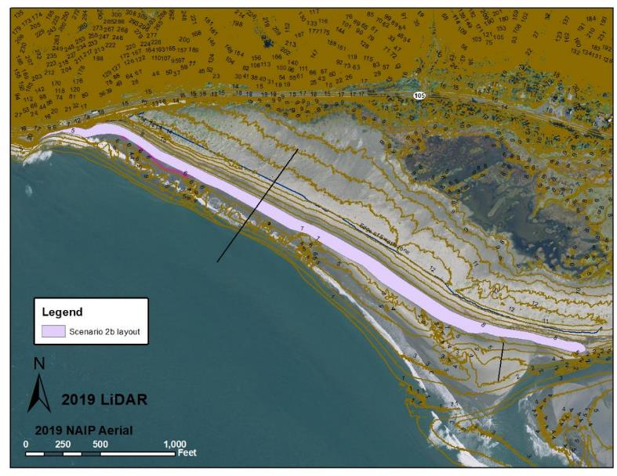
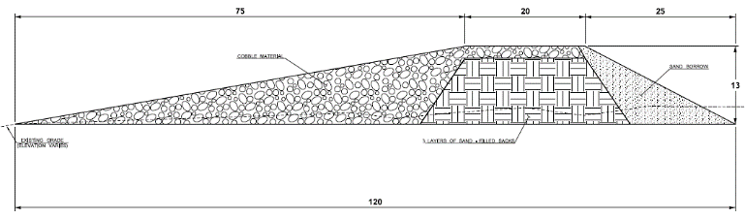
Update on Implementation - Design
- Ground Survey
- Drone
- LiDAR
- Bathometric Survey
- Scenario Layouts
- Preliminary Design

Slide 8
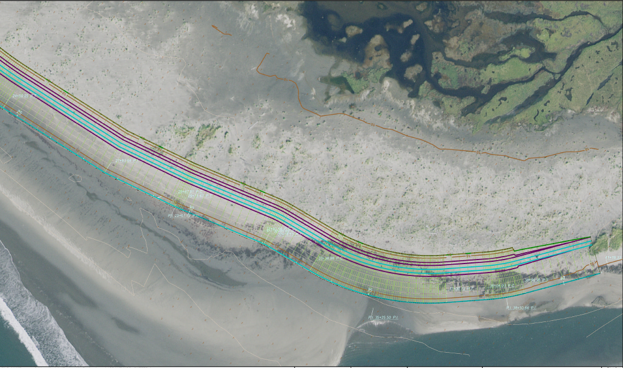
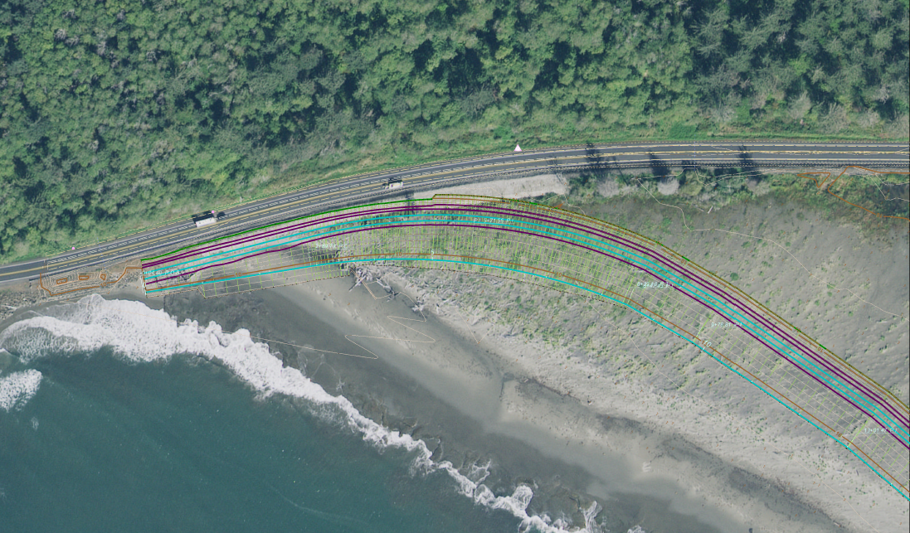
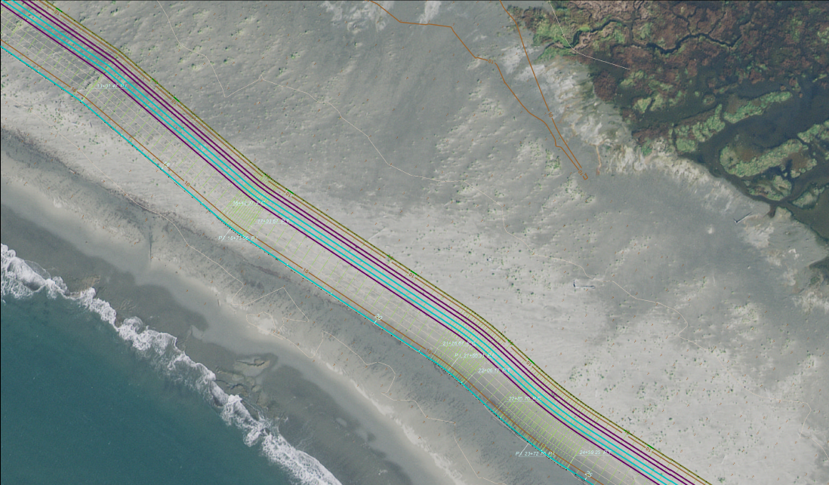
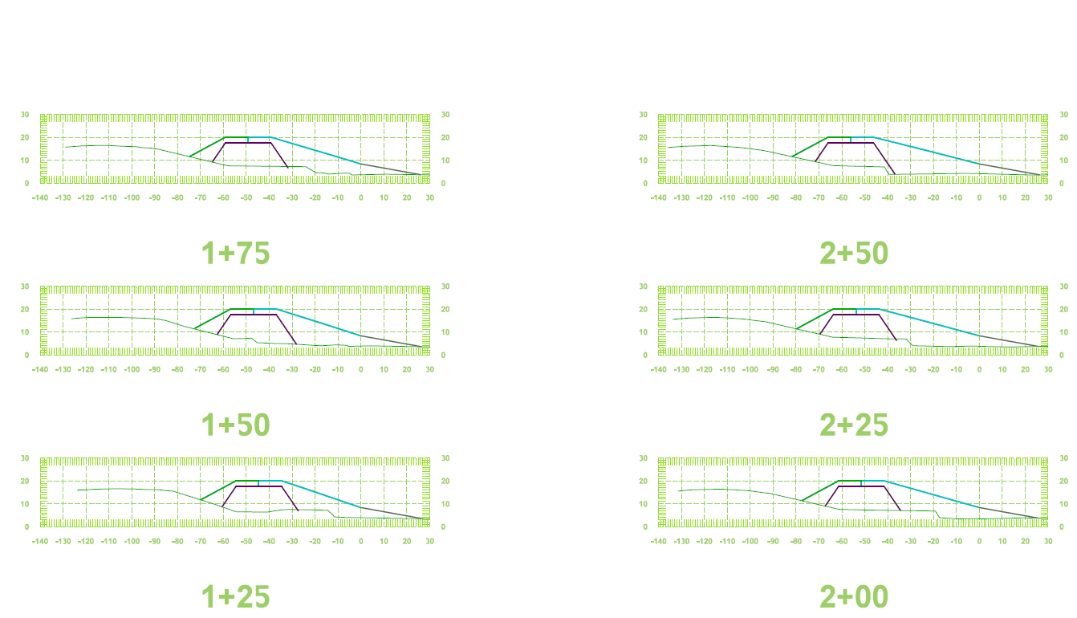

Slide 9
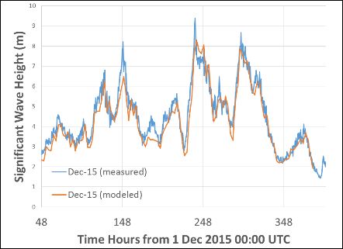
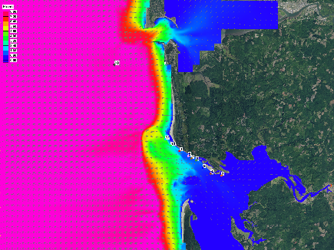
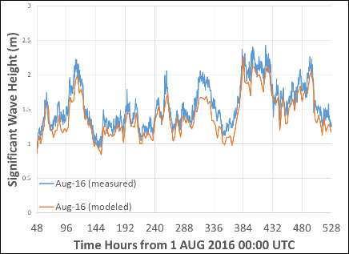
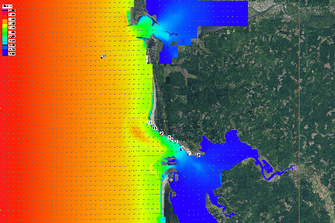
Army Corps Modeling -
WAVE HEIGHT
Winter storm
southwesterly
Mild summer condition
northwesterly

Slide 10
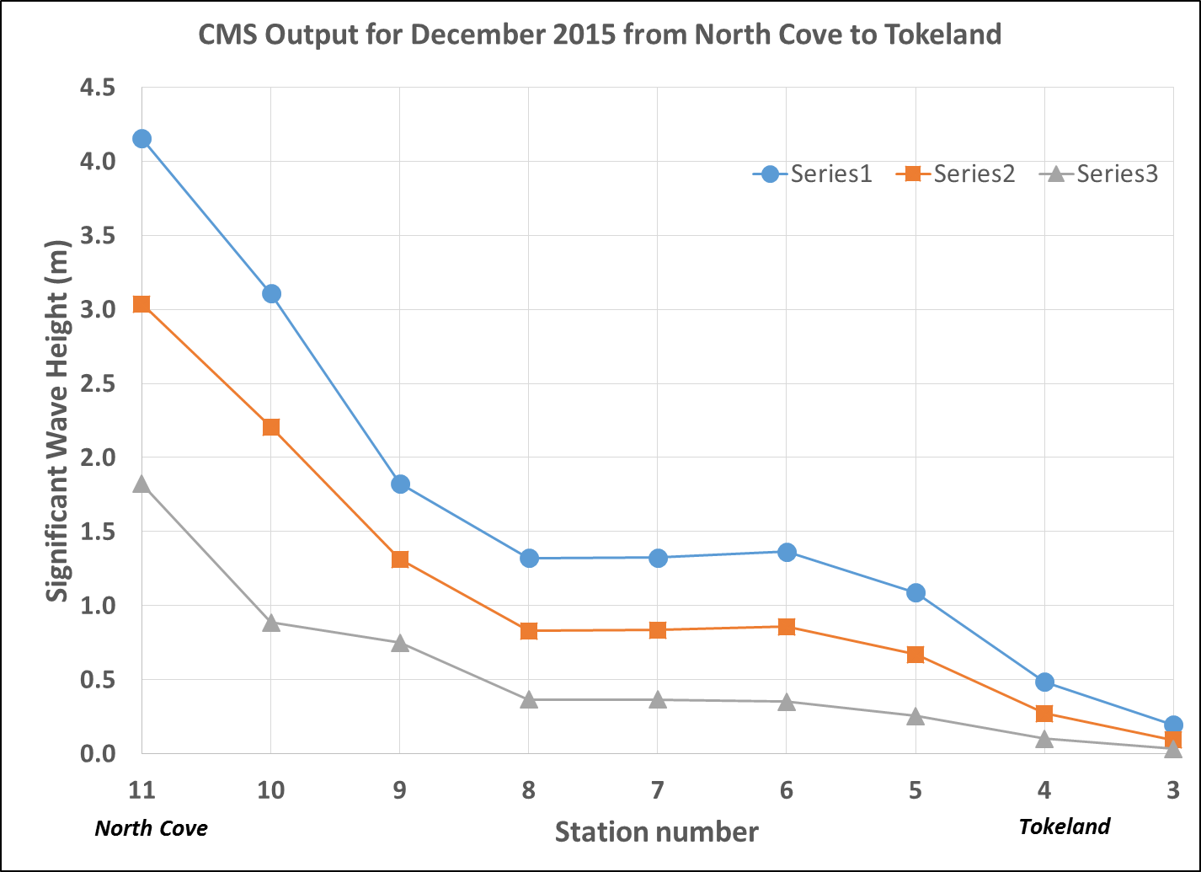
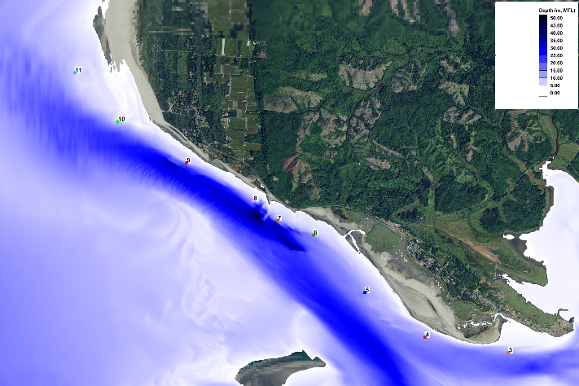
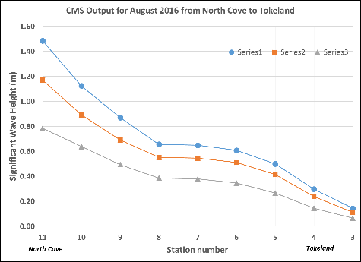
NEARSHORE WAVE HEIGHT
Depth limited waves
Max, Median, Min
Max, Median, Min

Slide 11
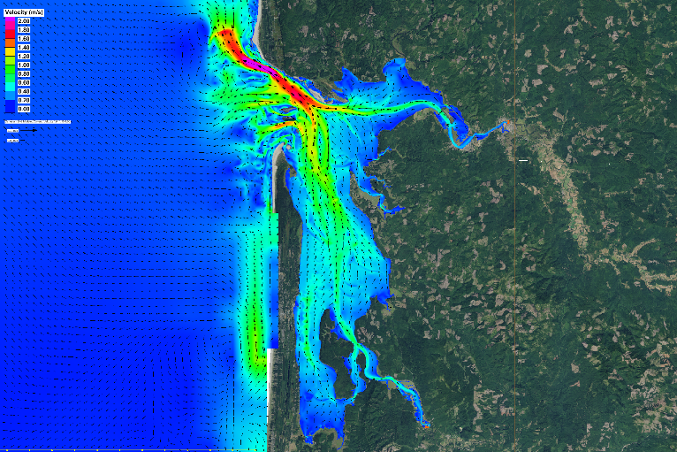
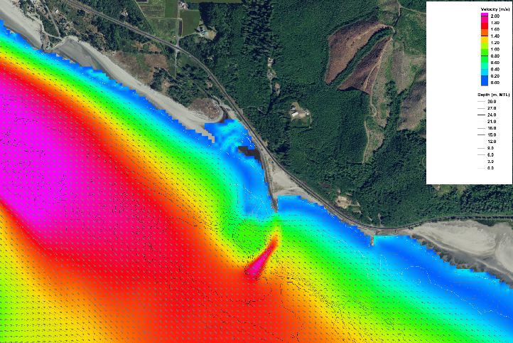
CURRENTS
Peak ebb: 12/11/15 01:00 UTC
Max speeds > 2m/s (4 knots)
Notes:
Dave - CURRENTS

Slide 12
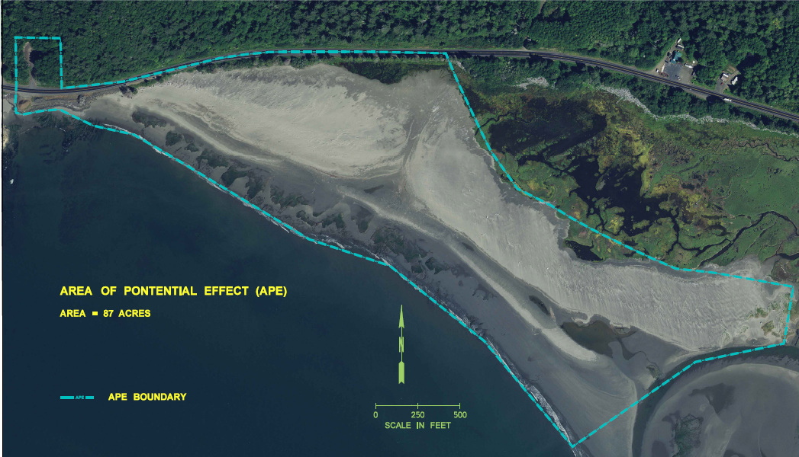
Update on Implementation – Project’s APE
Start of Tribal Coordination & initiation of Section 106
NEXT STEPS –
Rights of Entry
Delineations
  Marine Ordinary High Water Mark (OHWM)
  Wetland Delineation
  High Tide Line (HTL)
  Mean higher high water (MHHW)
Shoalwater Bay Tribe

Slide 13
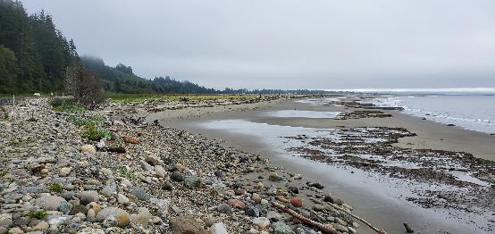
Update on Implementation
NEPA Environmental Assessment (EA)
SEPA Adoption of NEPA EA
Endangered Species Act (ESA) Consultation
  NOAA – National Marine Fisheries Service (NMFS)
  United States Fish and Wildlife Service (USFWS)
Section 106 & Tribal Coordination
Army Corps Individual Section 404 / Section 10
Ecology & EPA - Section 401 / CZM
Washington Department of Fish and Wildlife (WDFW) Hydraulic Project Approval (HPA)
Pacific County Shoreline & CAO
Coordination with State Parks, DNR & WECAN
Environmental Documentation & Permitting

Slide 14
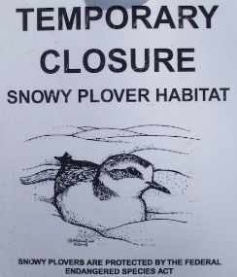
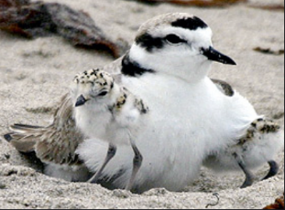
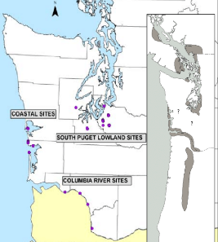
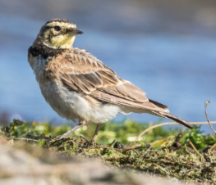
Anticipated Environmental Challenges
ESA Listed Species & Public Access Concerns
  Western Snowy Plover
  Streaked Horned Lark
    Formal ESA Consultation (~1yr for Biological Opinion)
    BiOp commitments may including:
      Work Timing Restrictions – nesting windows
      Temporary site closures & monitoring
Marine In-water Work Window (IWWW)
Critical Areas Mitigation Costs Unknown
  On-site restoration vs. Mitigation Bank Credits
NEPA & Permitting to be completed by Spring 2023
  Environmental is Critical Path to Construction*
Western Snowy Plover
Streaked Horned Lark

Slide 15
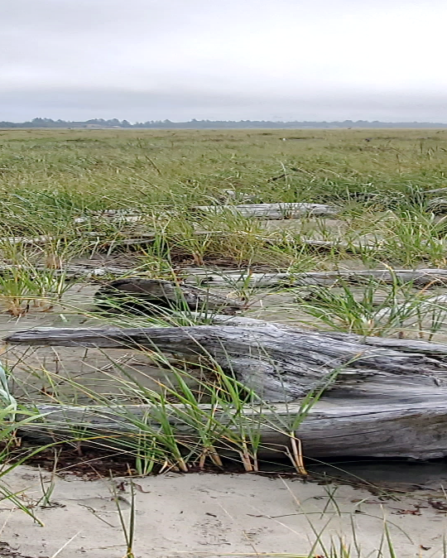
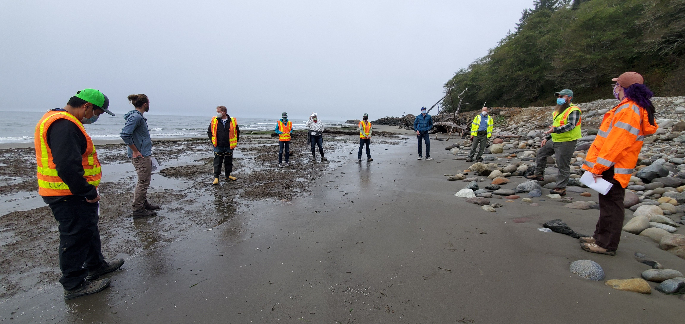
Activities to Address the Problem
Continued Coordination:
Public Involvement & Subcommittees

Slide 16
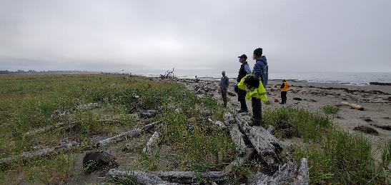
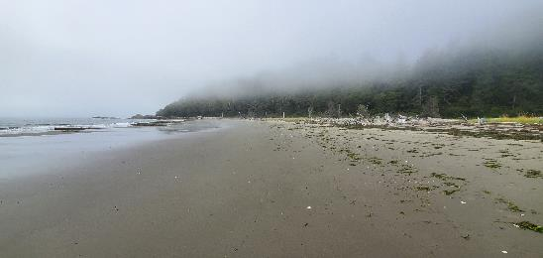
Anticipated Implementation Challenges & Next Steps
Processes delayed due to COVID19
Timeline of large scale construction project
  On-going erosion threatening SR105
  Looking into interim solutions
Required Real Estate
  Which agency to take the lead
Construction funding unknown
  Looking into Local, State & Federal funding
  Early cost estimates for Construction ~$24 million
  Monitoring and Adaptive Management

Slide 17
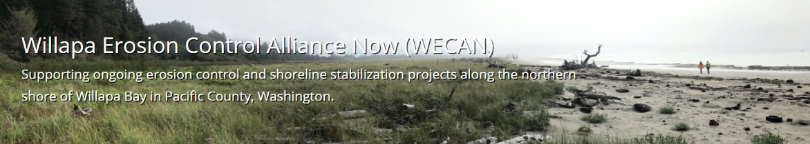
Thank you!
Graveyard Spit Restoration and Resilience Project
More information and updates may be found on the WECAN webpage:
Projects – WECAN | Washington Coastal Hazards Resilience Network (wacoastalnetwork.com)

