Slide 1
Coasts – Camera – Action:
Project Update
WECAN Meeting
14 August 2024
Project Partners: Roxanne Carini (UW), Nicole A. Errett (UW), Ashley Moore* (UW), Juliette Randazza (UW), Connie Allen* (Wash Away No More),
George Kaminsky (WA Ecology), Henry Bell (WA Ecology)
*presenting today
Funded by:

Slide 2
Project Overview
Our Goal: To measure beach changes and inform beach restoration using photos taken at existing beach photo stations and community knowledge of local erosion.
Our Process: Using the photos you submit and the GPS field survey from WA Ecology, we will process beach imagery to measure how much the beach width changes over relatively short time periods (e.g., one week, a single storm event, etc.). We will combine this information with results from the focus group discussions and create an interactive display for the community. We will use your feedback to inform next steps.

Slide 3
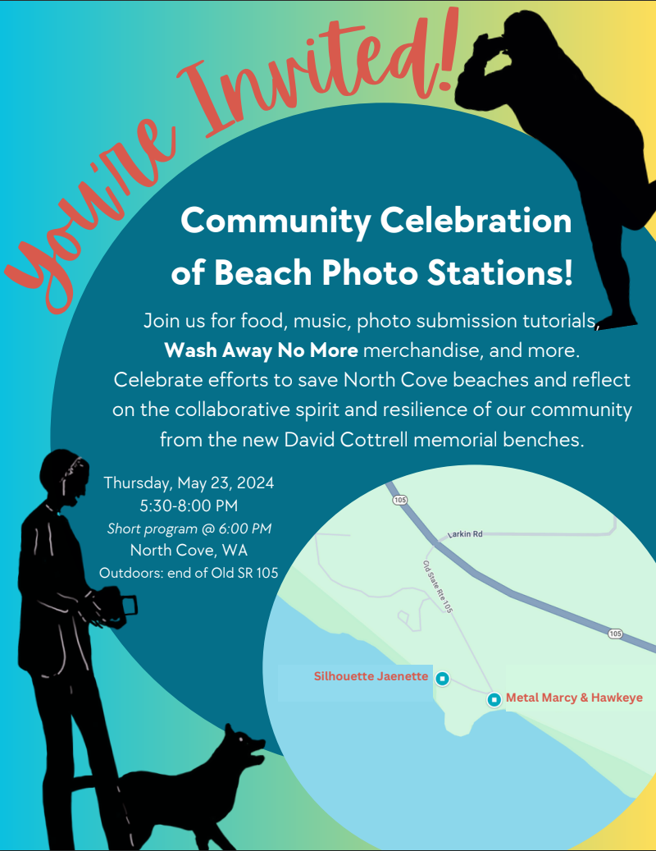
Relaunch Event Recap
Over 75 attendees!
Short Program about the project
… and Connie played the banjo!
Photo Submission Tutorials
… and statue dress-up… and the real Marcy & Jaenette!
Taco Truck
Rock/revetment-themed music
Wash Away No More swag
Potluck desserts
… with Dynamic Revetment cake!

Slide 4
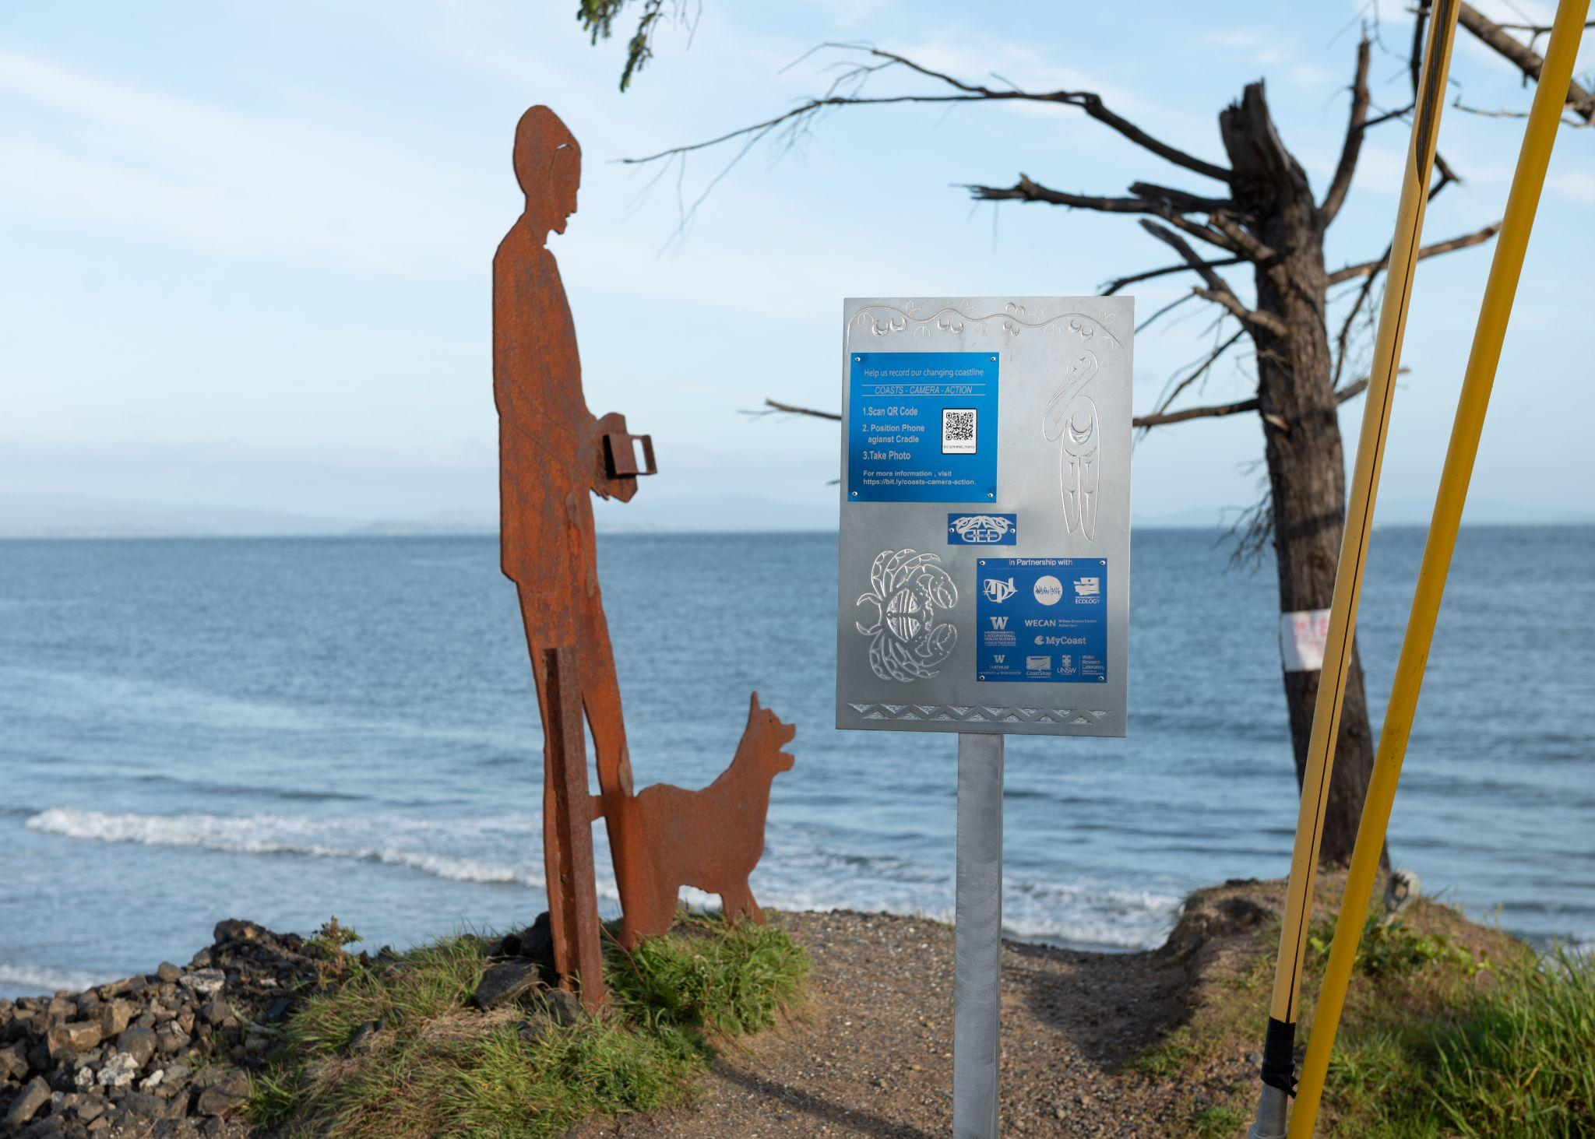
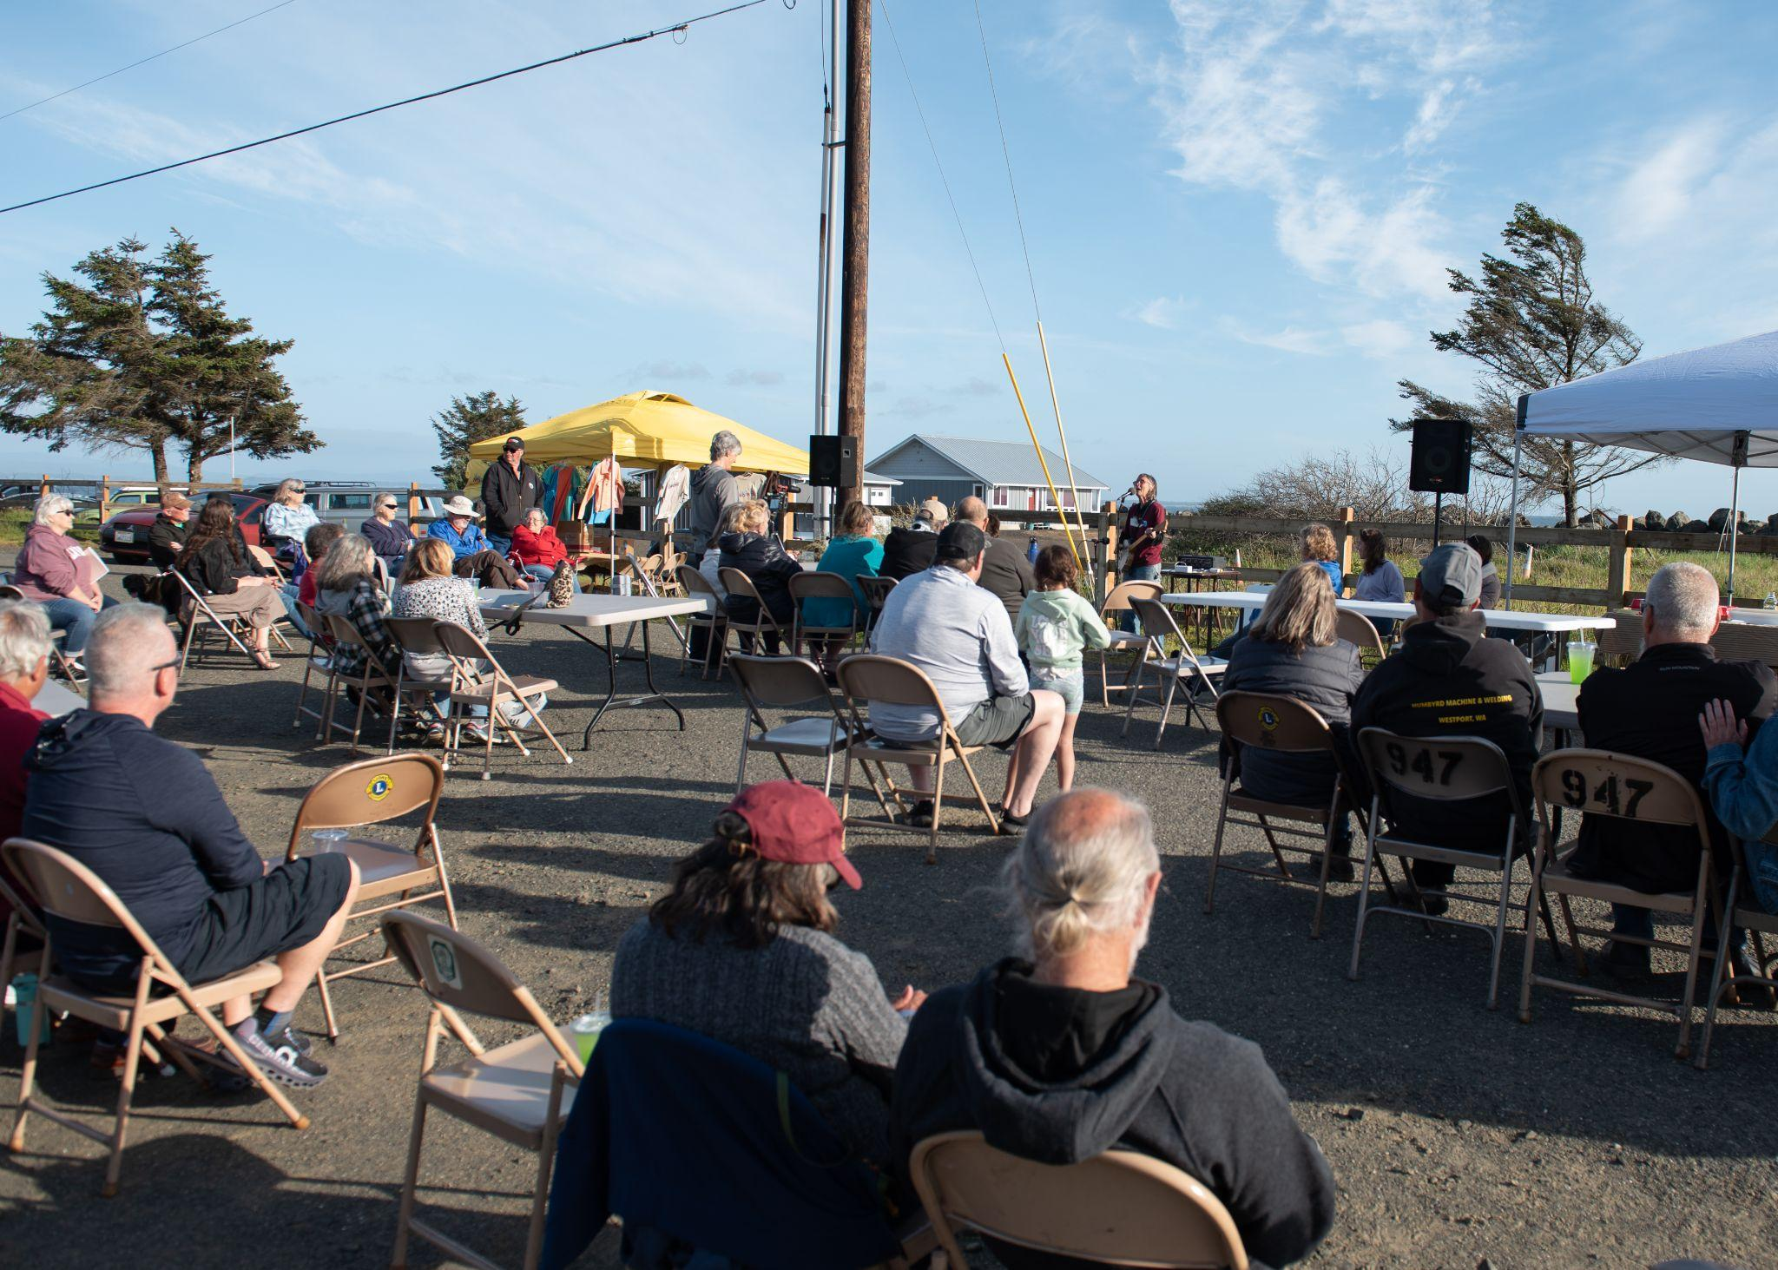
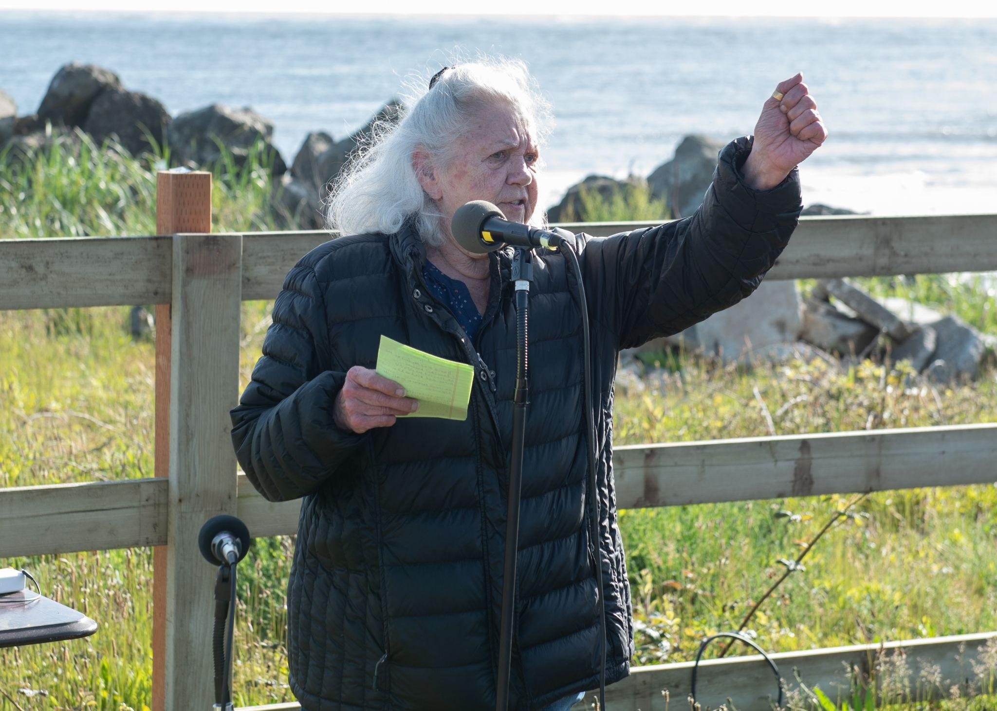
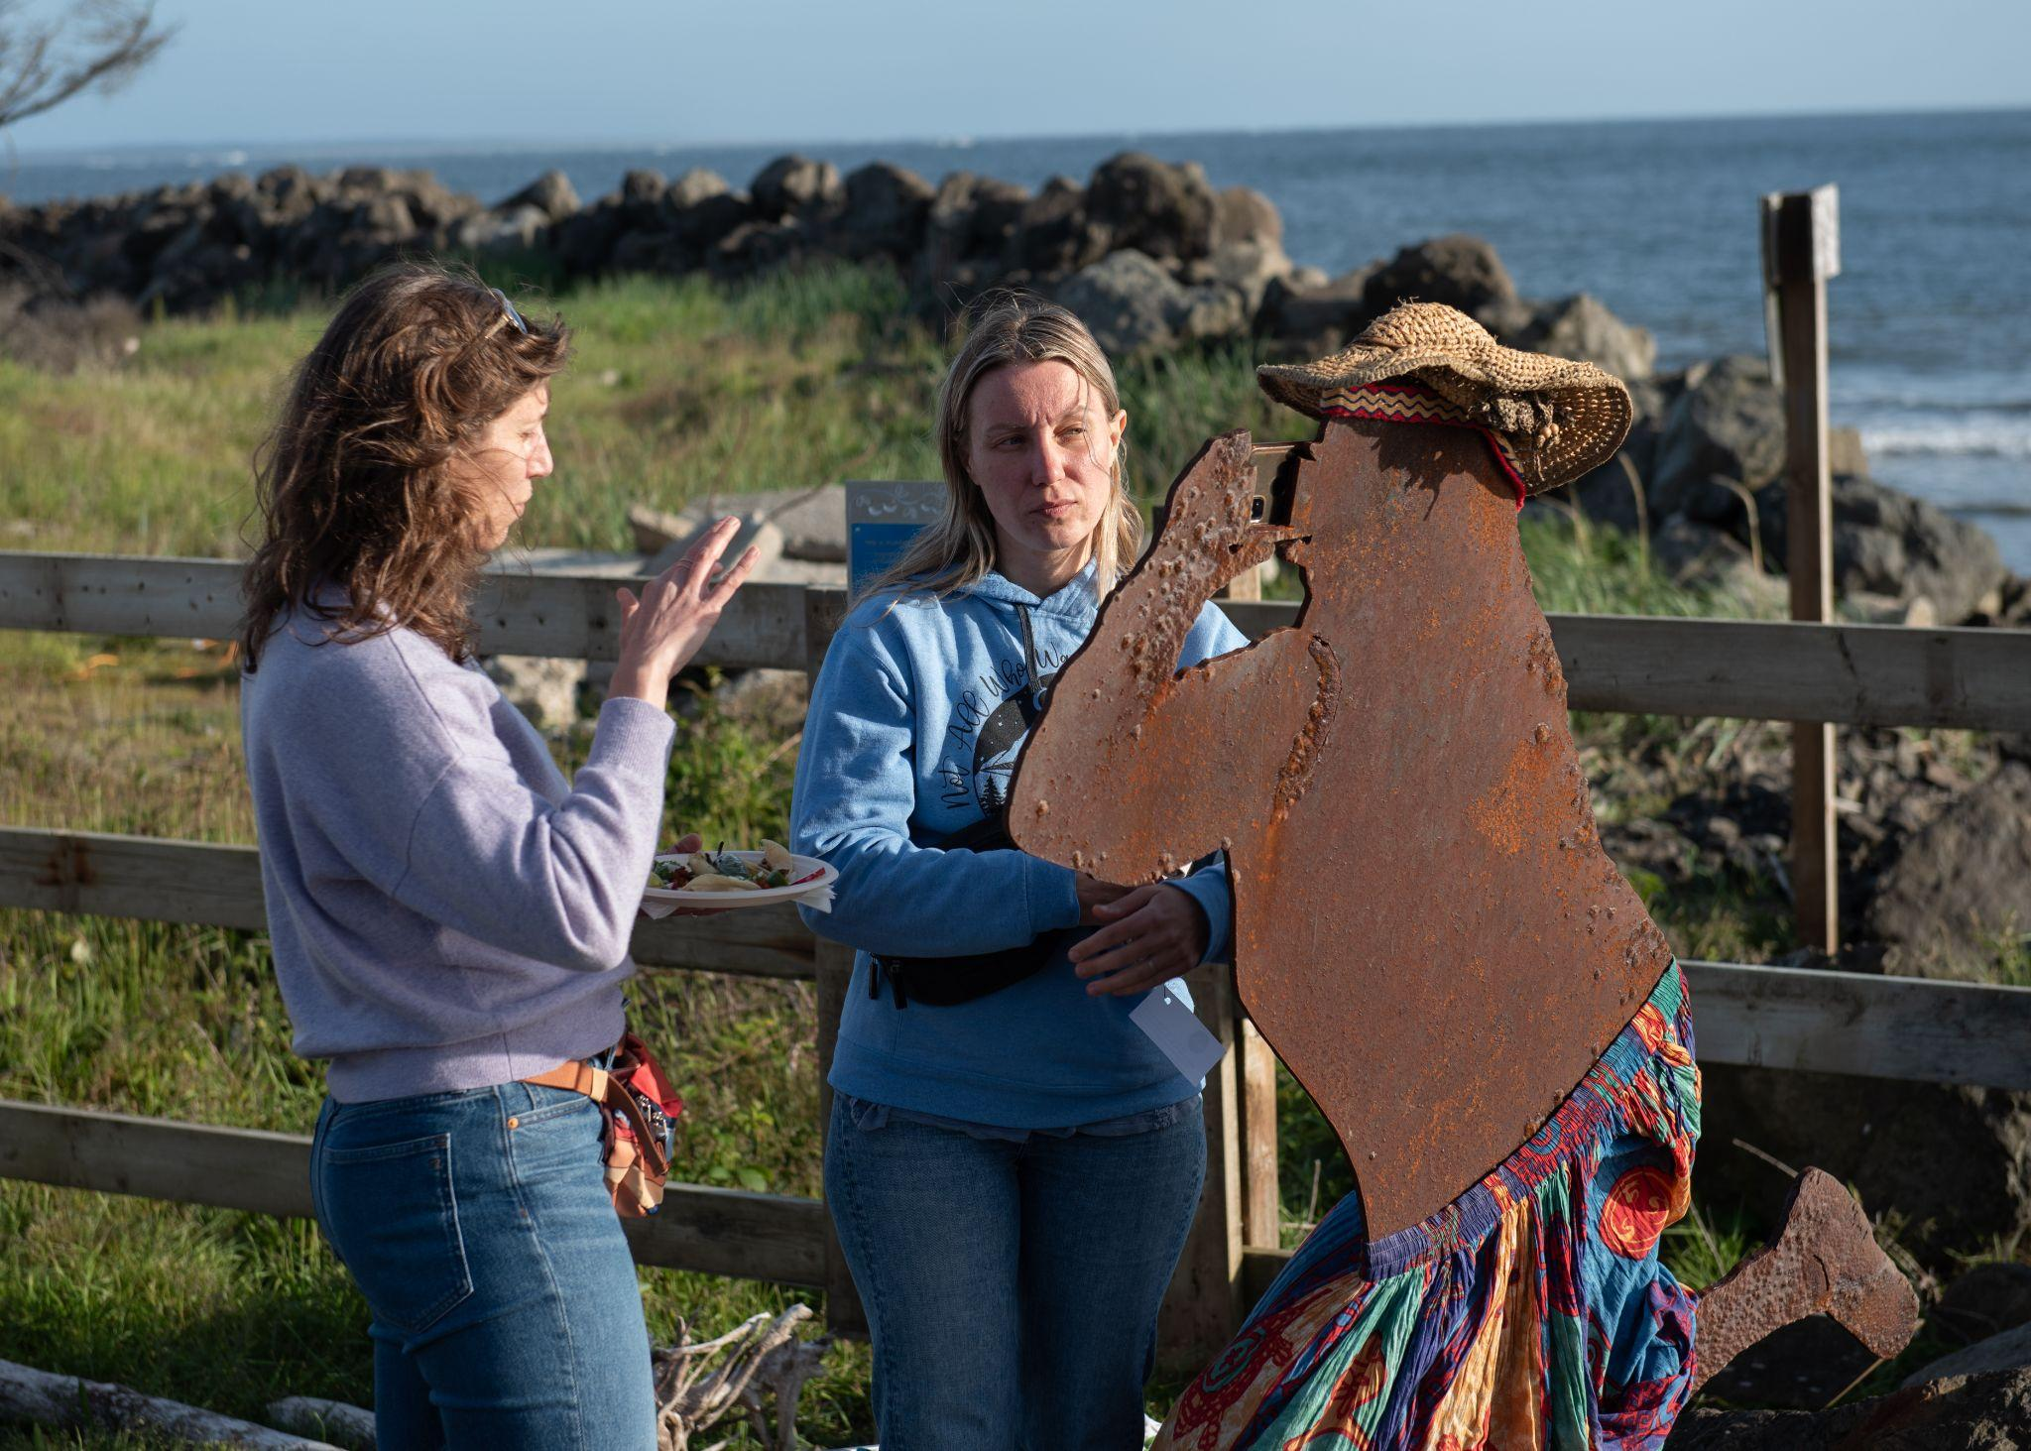
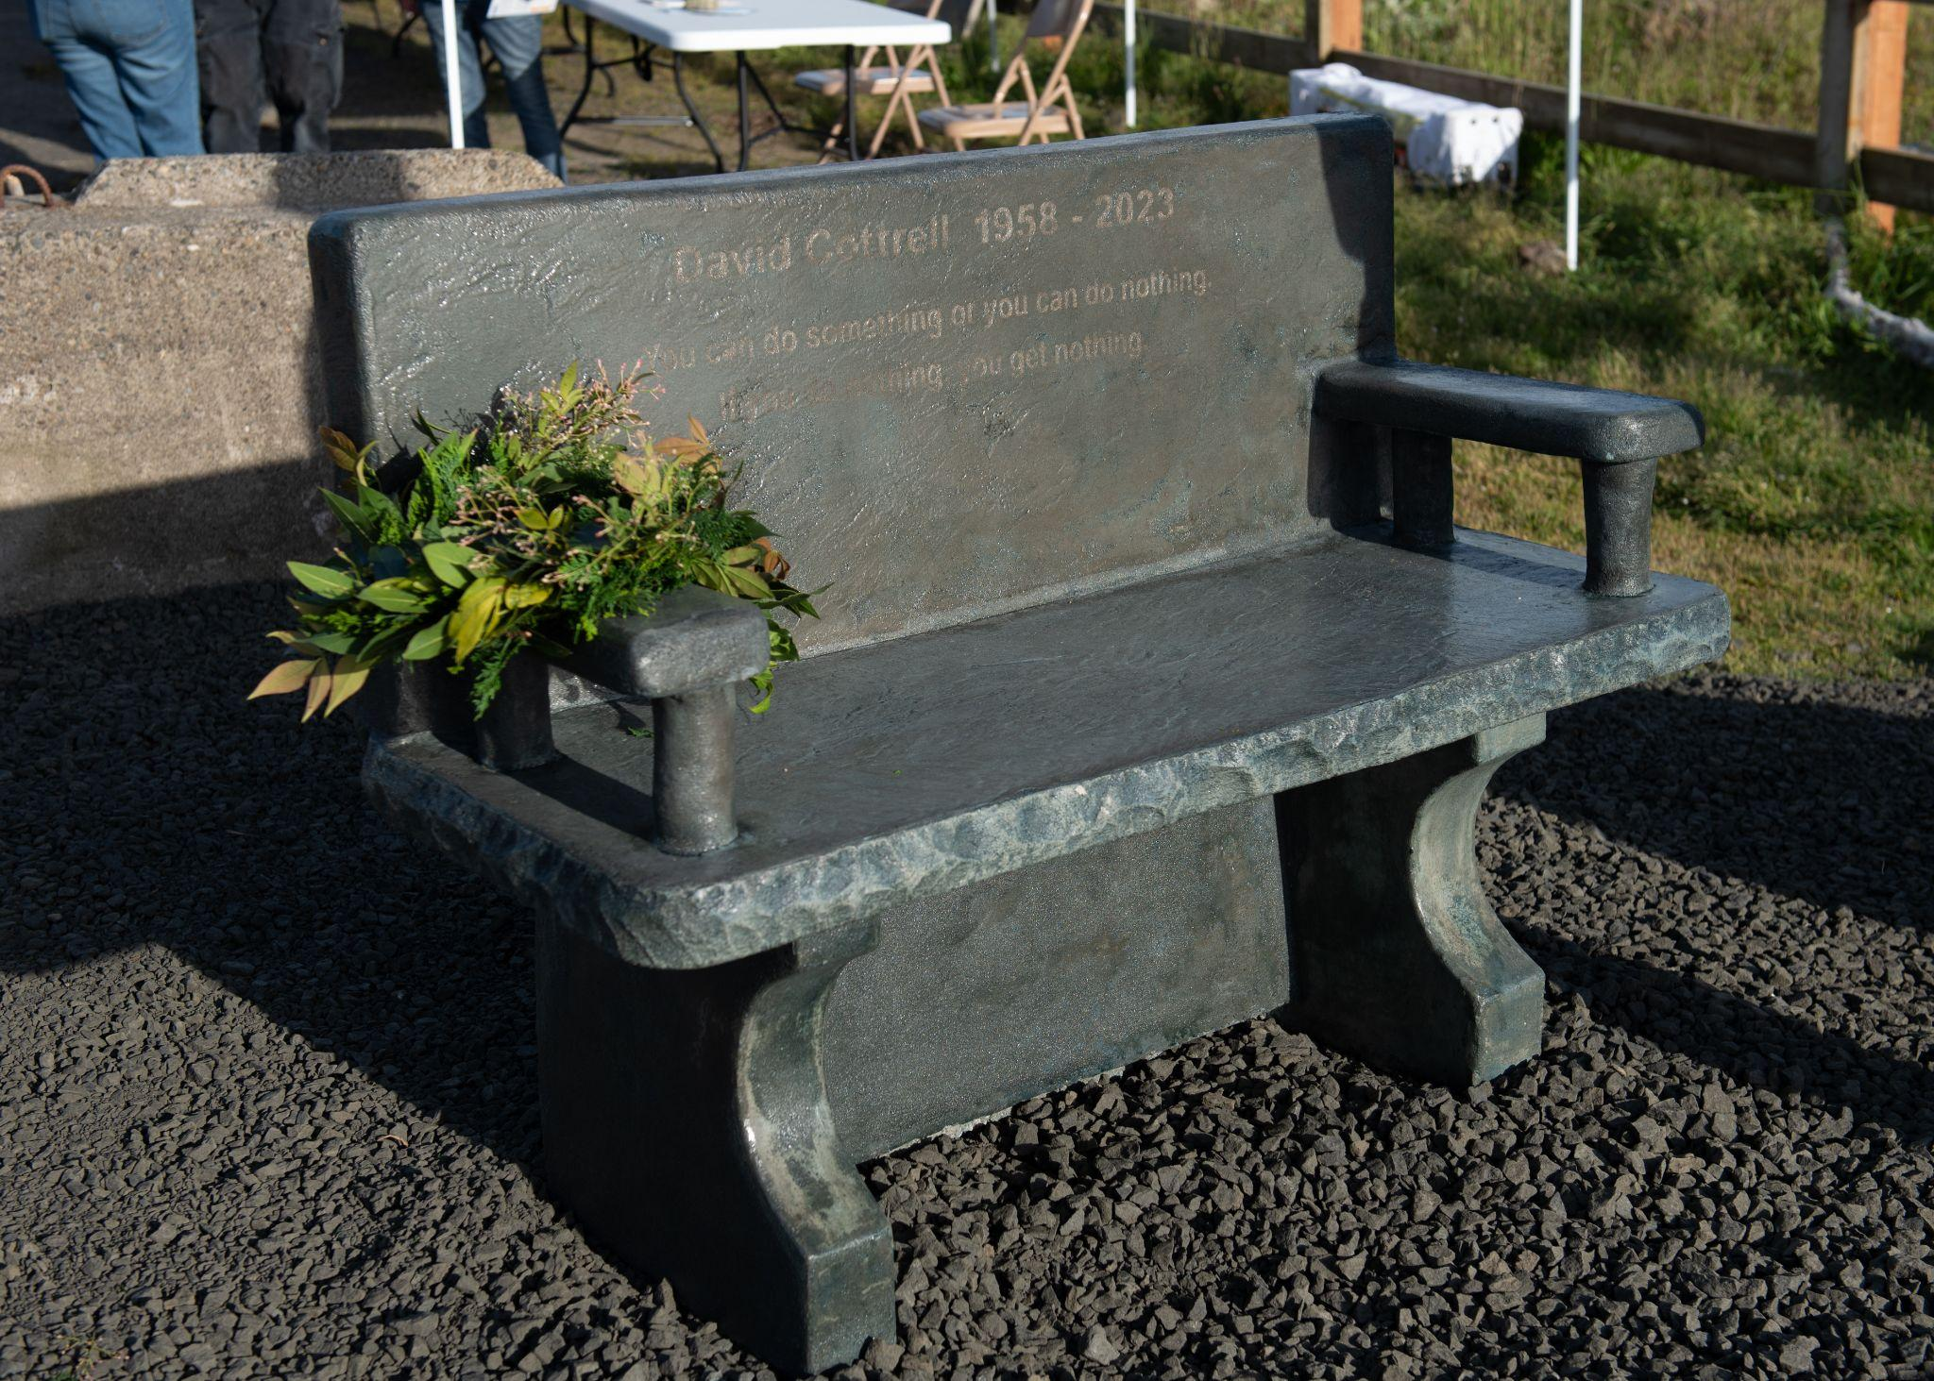

Slide 5
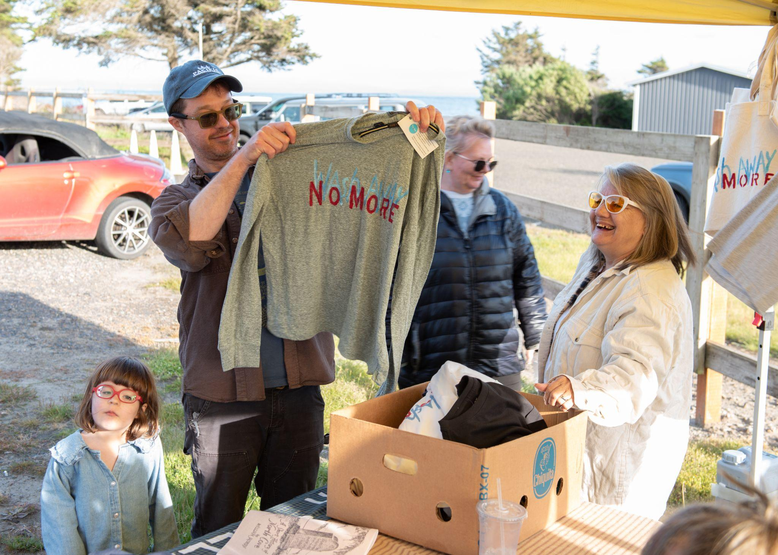
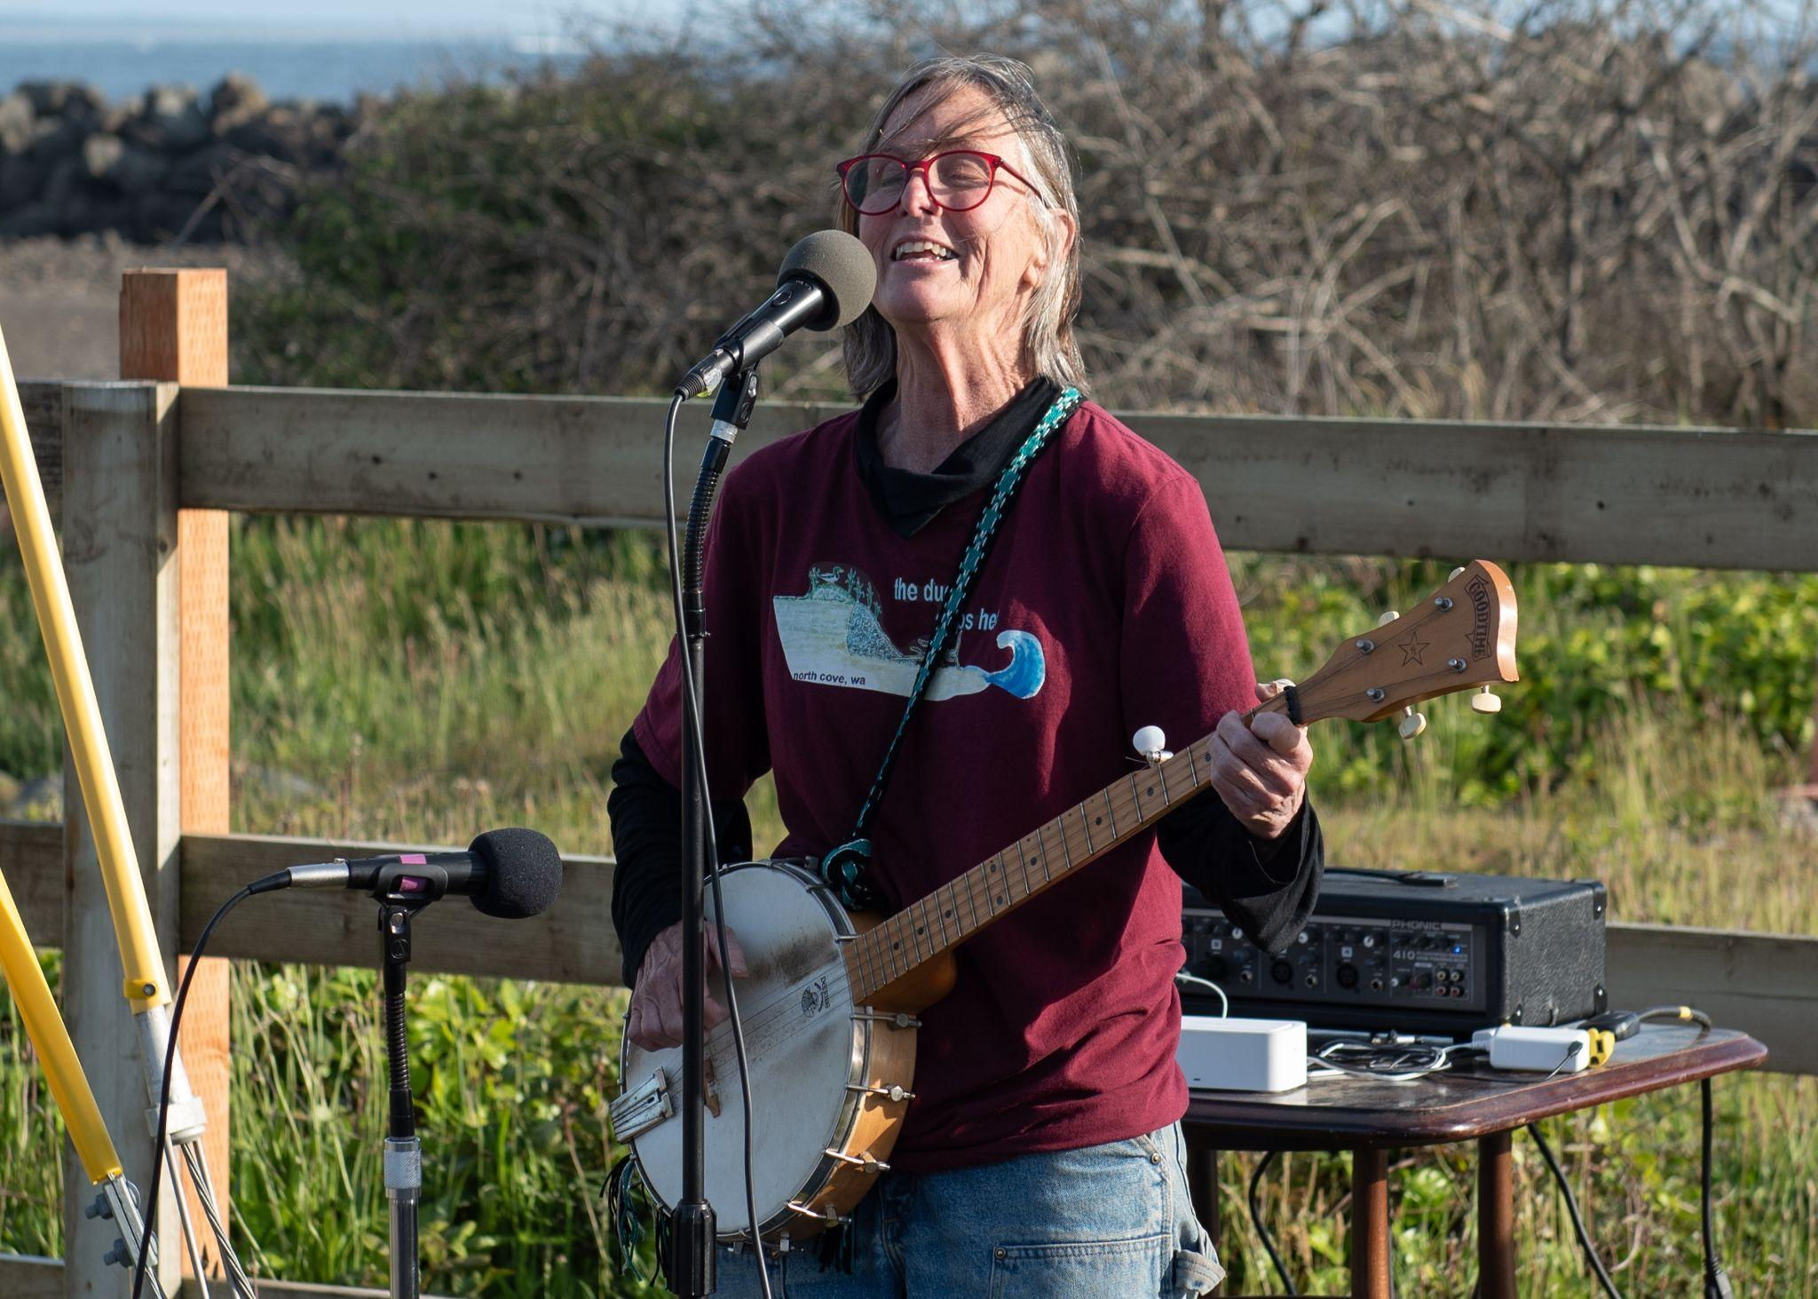
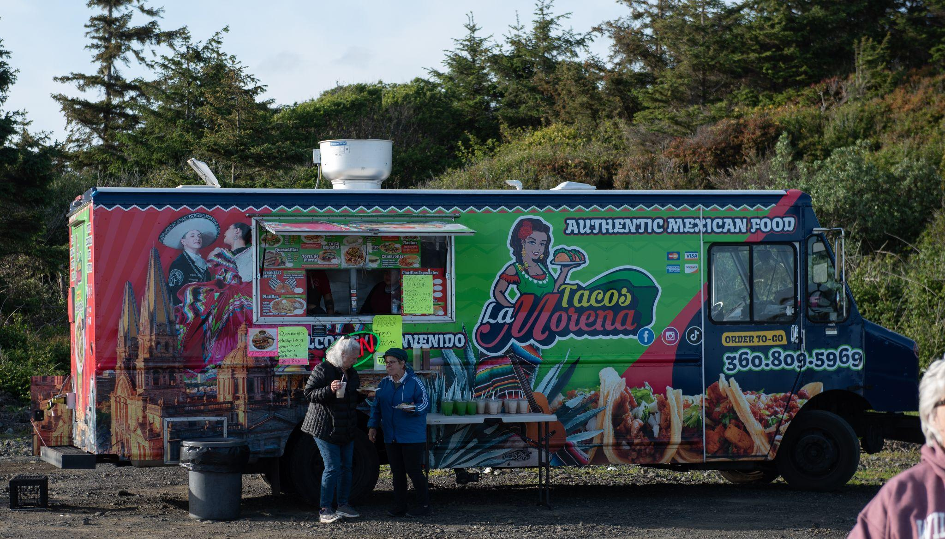

Slide 6
Focus Groups
5 focus groups, 3-6 participants each
Showed time series
Participants brought their photos
Questions asked:
What do you See here?
What is really Happening here?
How does this relate to Our lives?
Why does this situation, concern, or strength exist?
What can we Do about it?

Slide 7
Focus Group Themes
Theme 1: Place attachment contributes to residents’ worry about the loss of land and their motivations to protect it.
Theme 2: The need for outside support to build capacity coexists with the desire to remain independent.
Theme 3: Coordination among communities across the coast is critical for effective erosion control.
Theme 4: Erosion control has brought hope for the future, yet concerns remain about cross-coastal and ecological impacts.
Theme 5: Collective action has brought the community closer with a sustained motivation for change.

Slide 8
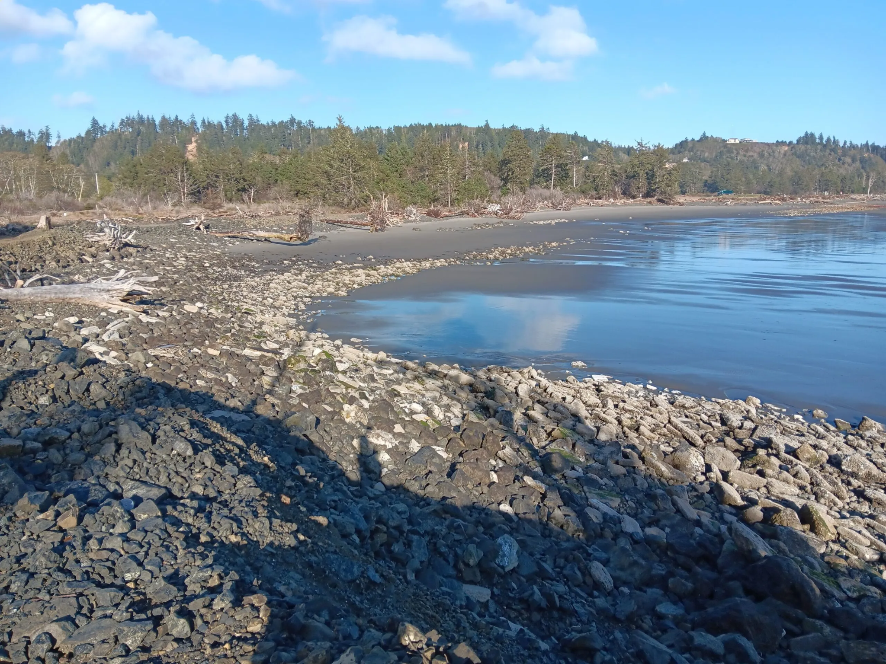
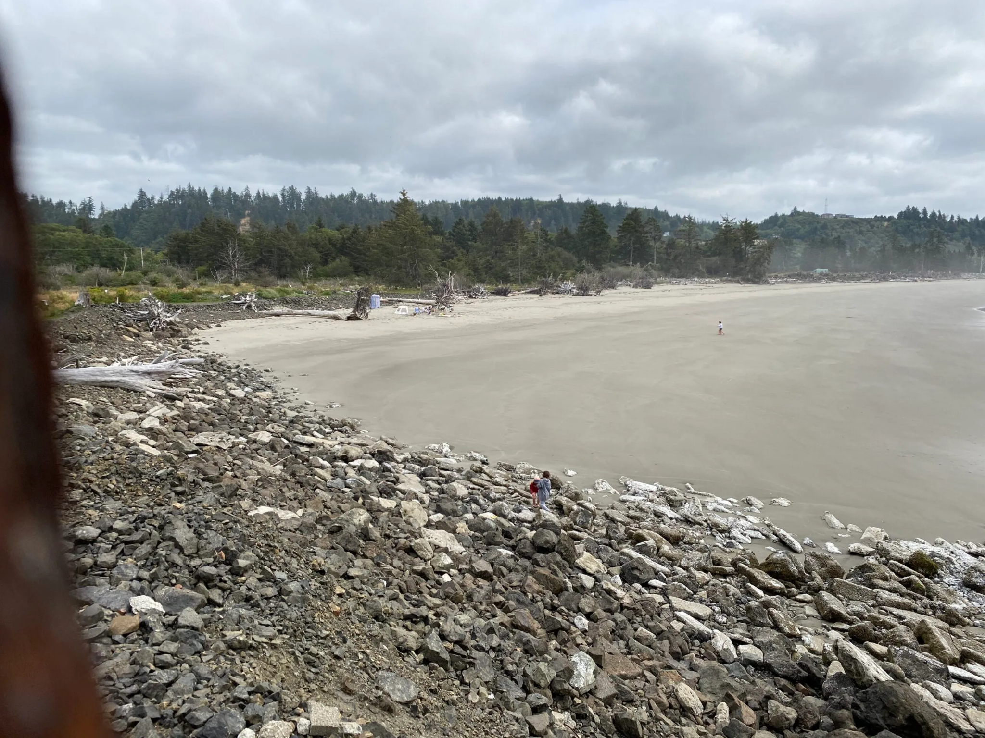
CoastSnap Preliminary Results:
Sand Retention at Metal Marcy
5 April 2024 - low tide
27 July 2024 - low tide

Slide 9
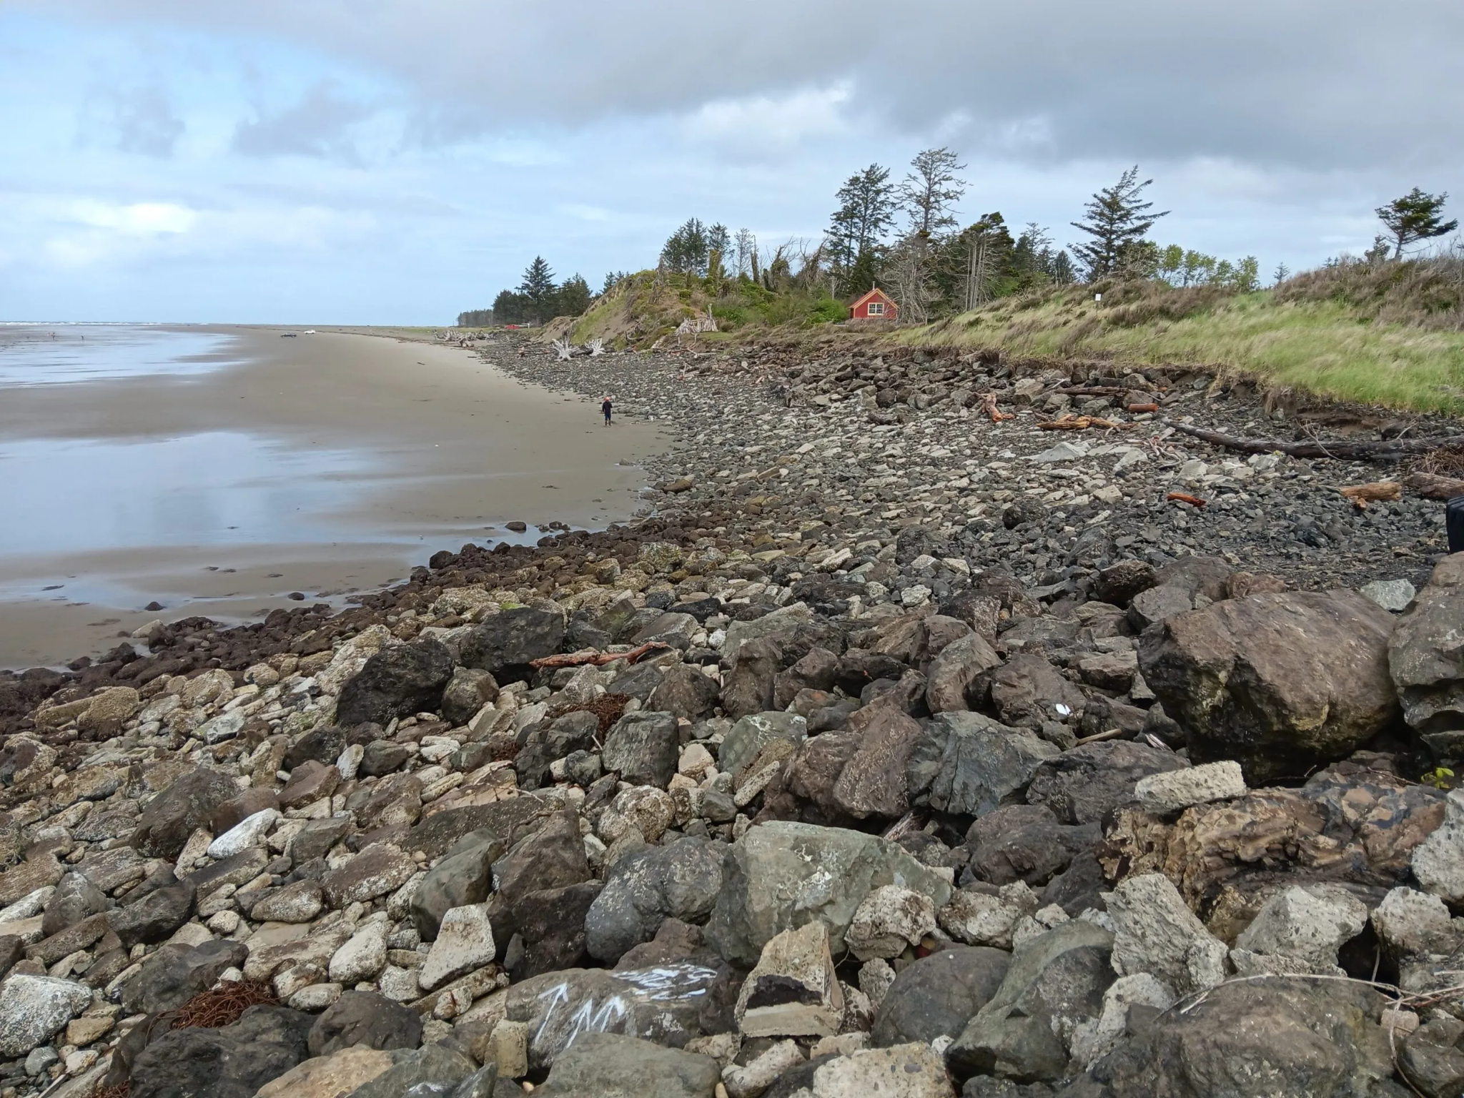
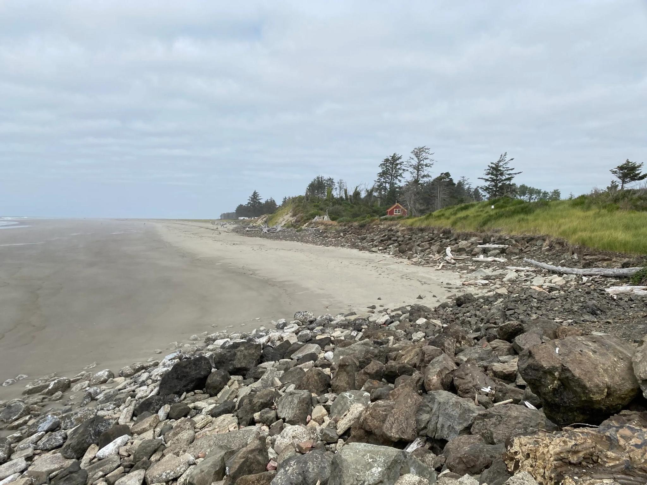
CoastSnap Preliminary Results:
Sand Retention at Silhouette Jaenette
28 April 2024 - low tide
27 July 2024 - low tide

Slide 10
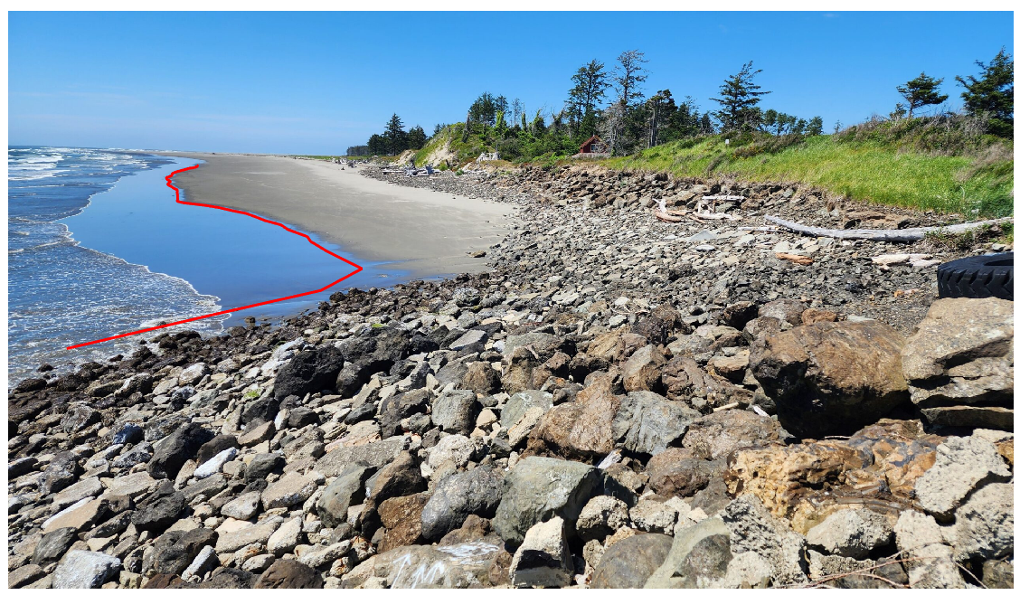
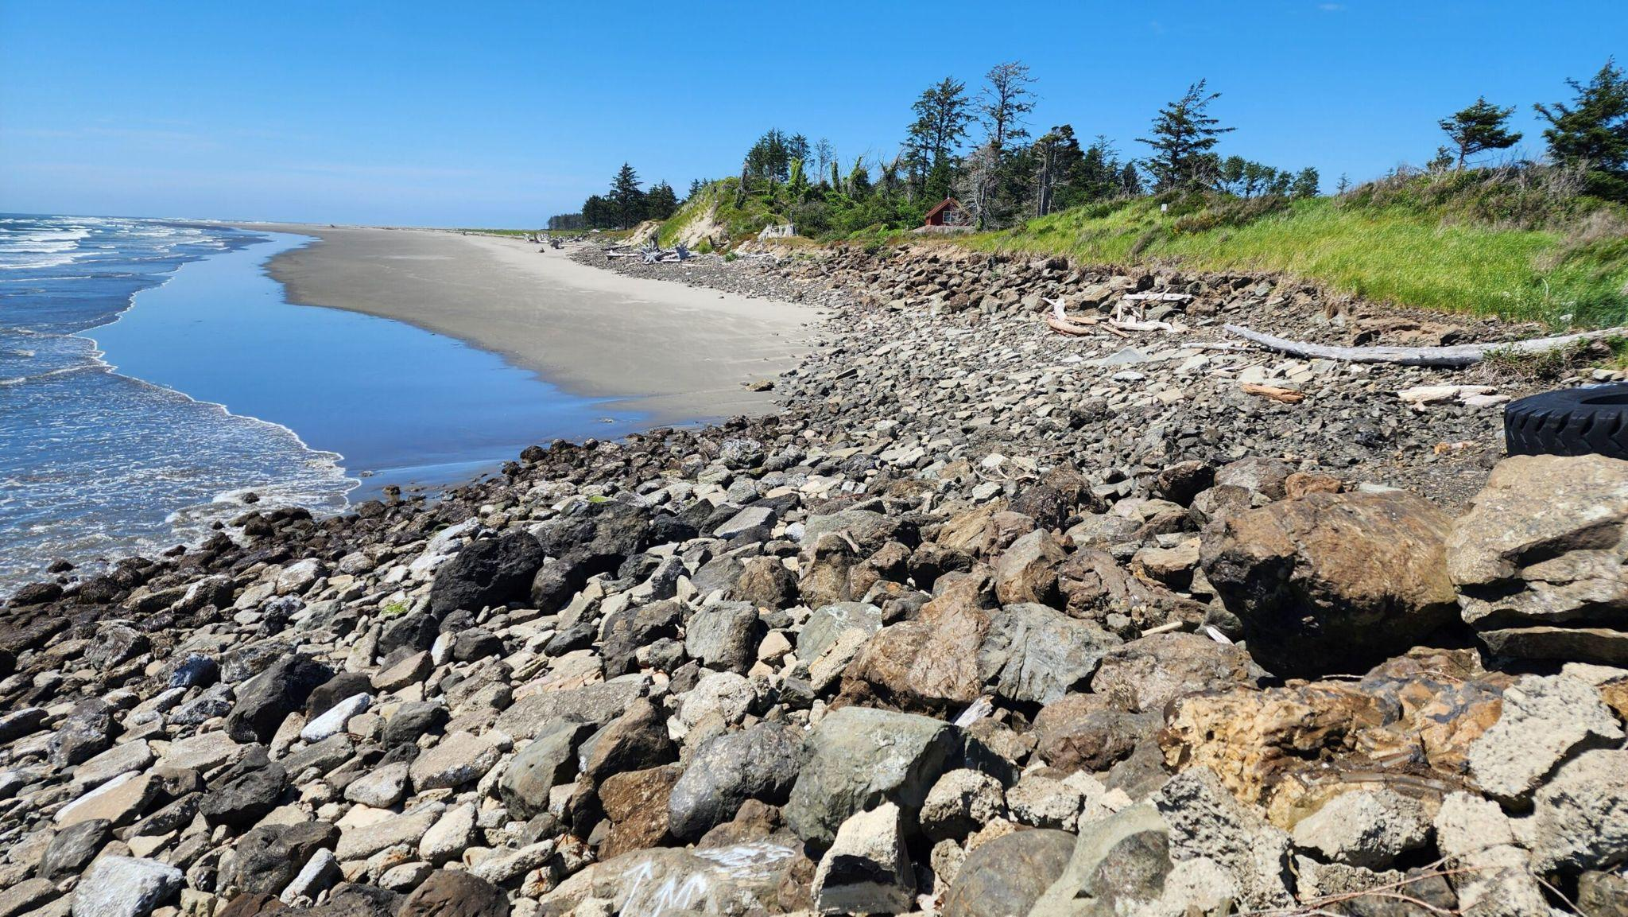
CoastSnap Preliminary Results:
Mapping shorelines before and after storms
June 10th, 2024: Post-storm beach
Notes:
5 days before a storm and 5 days after, comparing pictures
both pictures are within same tidal range

Slide 11
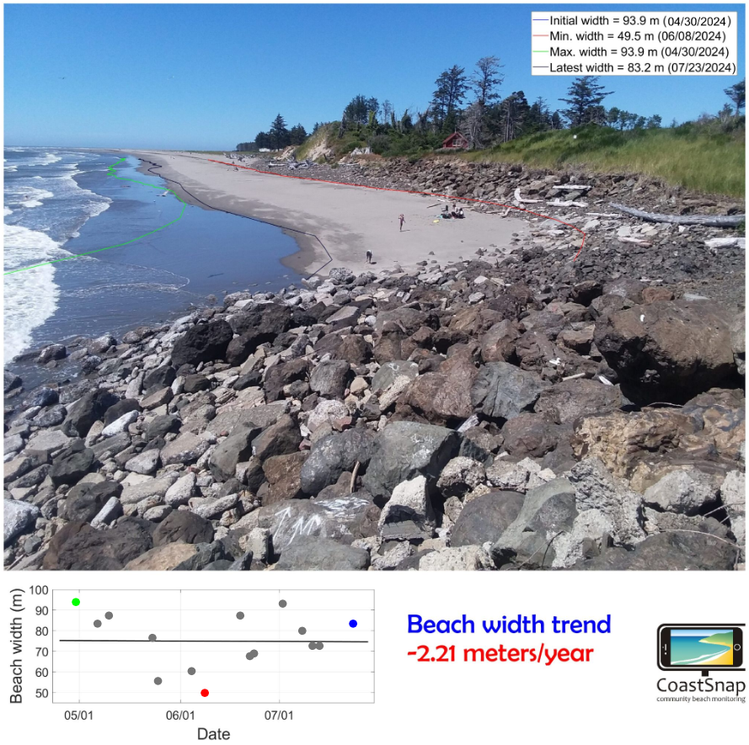
CoastSnap Preliminary Results:
Mapping shoreline change over time
Notes:
compared all of the photos, showed that the average change in beach width was a loss of 2.21 meters - this may not be super accurate because we need more photos!
compared the change of photos within the same tidal range
only ⅓ of images are usable: horizontal images and images with no visible waterline cannot be used

Slide 12
What’s next?
Co-designing final products for EarthLab pilot project
Data visualizations (plots, timelapse videos, infographics) combined with focus group discussion themes and quotes
Community art inspired by the data and focus group quotes
Others TBD
WA Sea Grant project begins
Informed by everything we’ve learned through the pilot project
Scoping new locations to Steely Van and Petite Marguerite based on community suggestions and feasibility

Slide 13
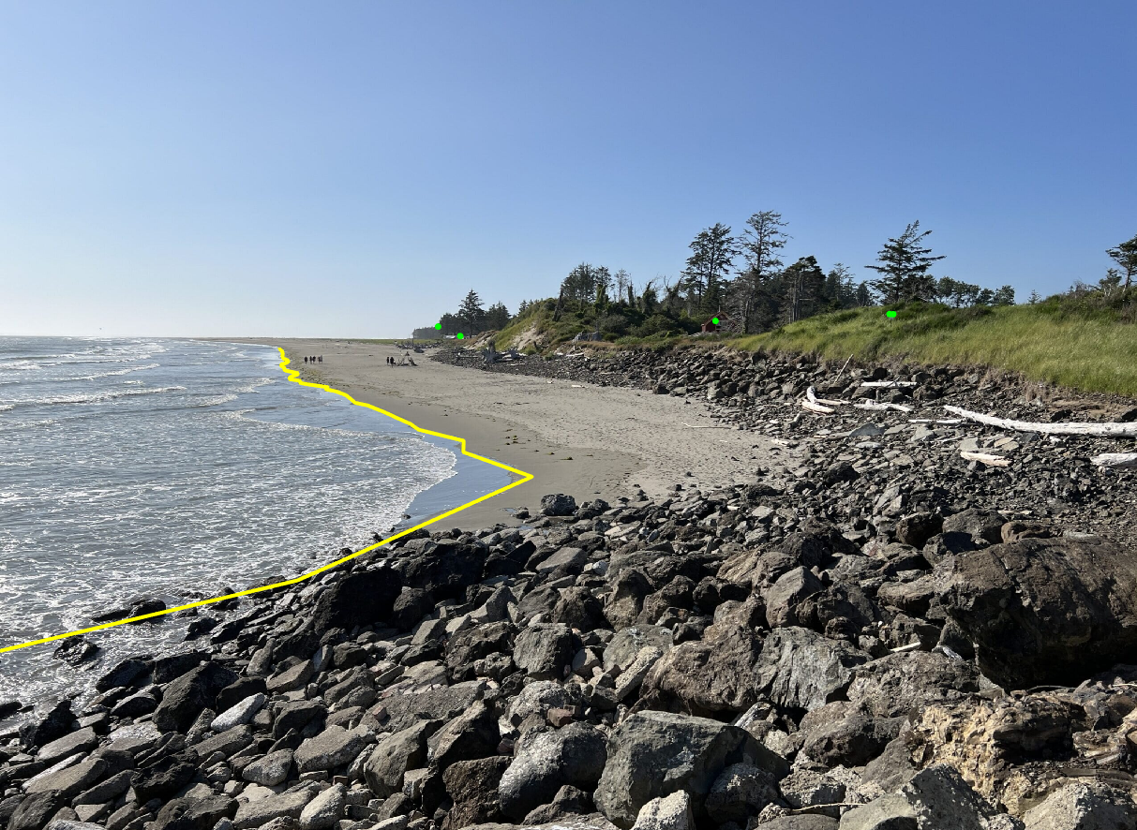
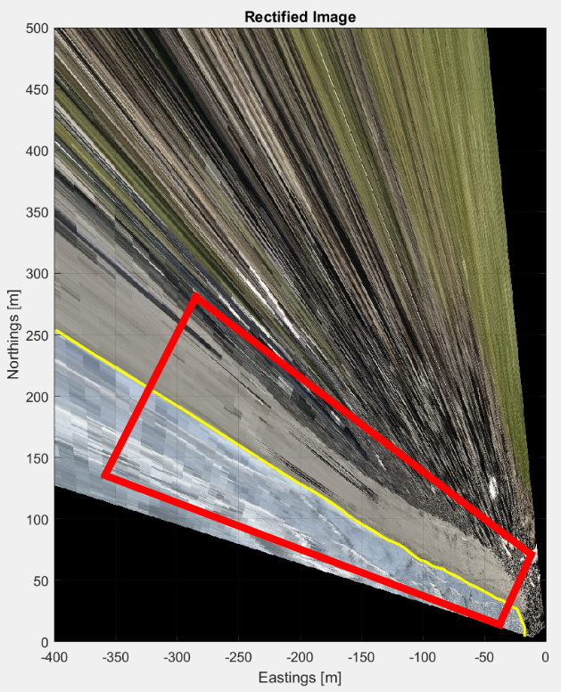
Feasibility Consideration:
Raw and Rectified side-by-side
Trade offs between elevation and alongshore resolution
Notes:
Annotated images to show what part of the shoreline we map
Trade off of elevation and alongshore resolution (what we can map accurately)

Slide 14
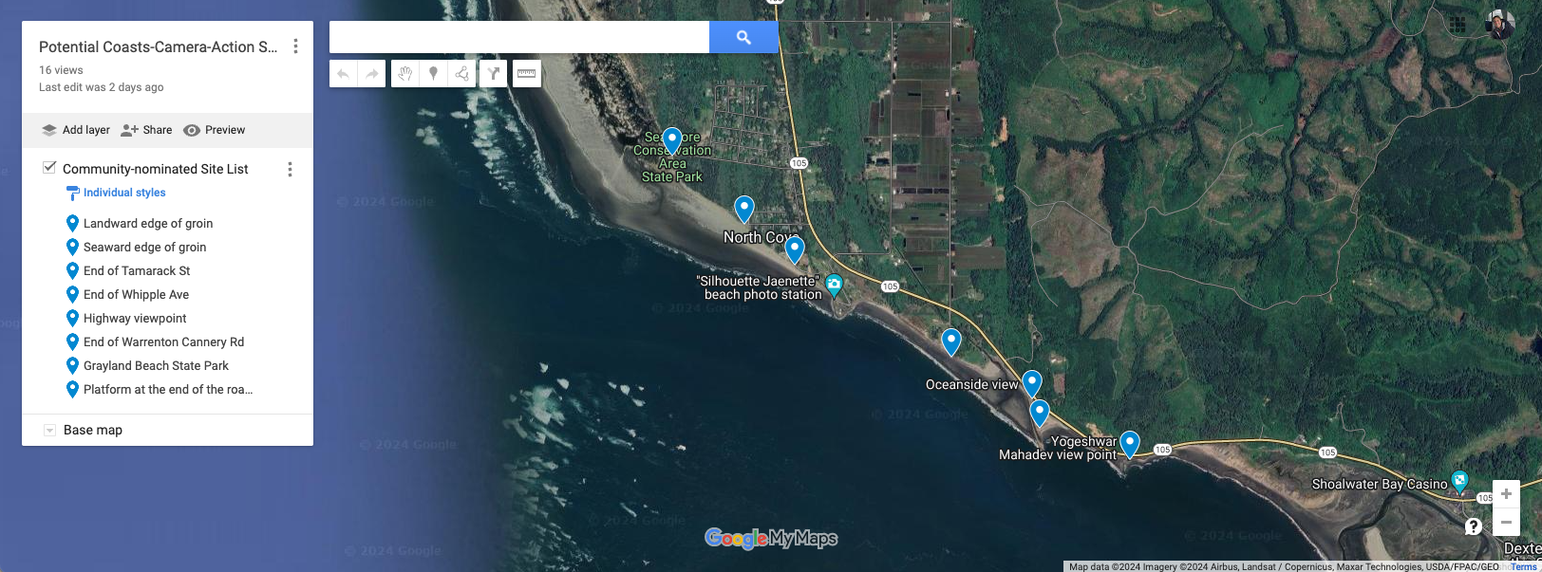
Future site ideas (suggested by community)
We need to discuss site options with: WSDOT, WDFW, Parks Service, others?
Notes:
ask Roxanne what icons mean

Slide 15
Please keep submitting beach photos:
Participation Statistics
Metal Marcy total images | 63
Metal Marcy average images per week | 0.66
Silhouette Jaenette total images | 99
Silhouette Jaenette average images per week | 1.03
Percent of usable images from submissions (based on from cradle, landscape orientation, visible GCPs, visible water line, tidal range comparison) | 34%
Most popular day for image submissions | Sunday

Slide 16
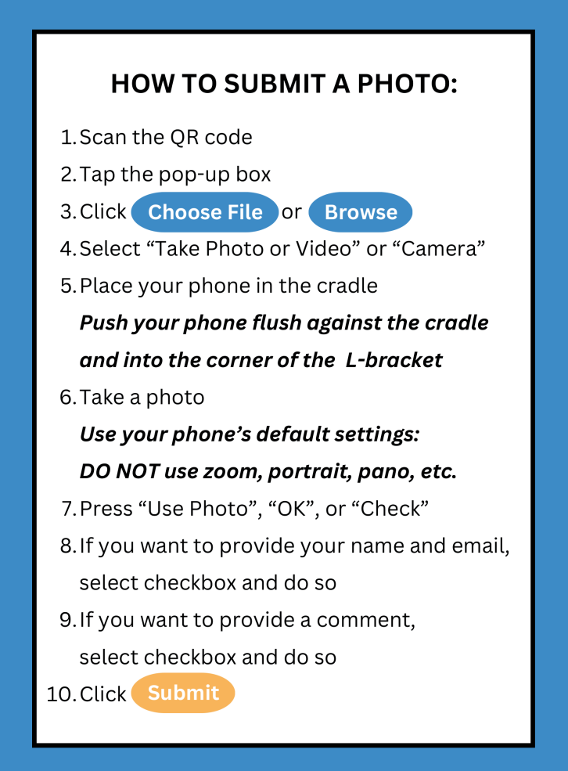
Please keep submitting beach photos:
Tips & Tricks
Hold your phone horizontally
Make sure you can see the water line in your photo
Do not zoom in or use wide angle
Submit photos at both stations (short walk)
Hoping to embed youtube tutorial video here, instead of these!

Slide 17
Questions?
Primary contacts:
Roxanne Carini (UW) - rjcarini@uw.edu
Connie Allen (Wash Away No More) - callen3@mail.com
Ashley Moore (UW) – amoore10@uw.edu

