Slide 1
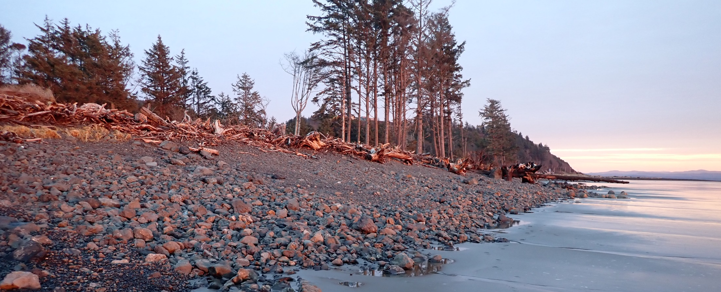
North Cove Project Update
WECAN Meeting
August 14, 2024
George Kaminsky, Sumaiya, Hannah Drummond, Amanda Hacking
Notes:
REVISED 11/16/2022 - AJ

Slide 2
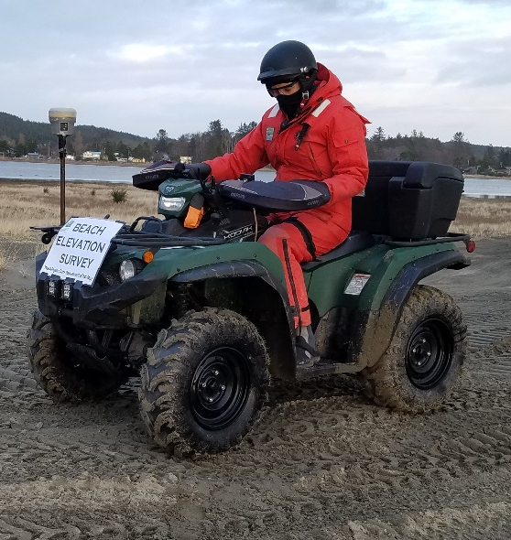

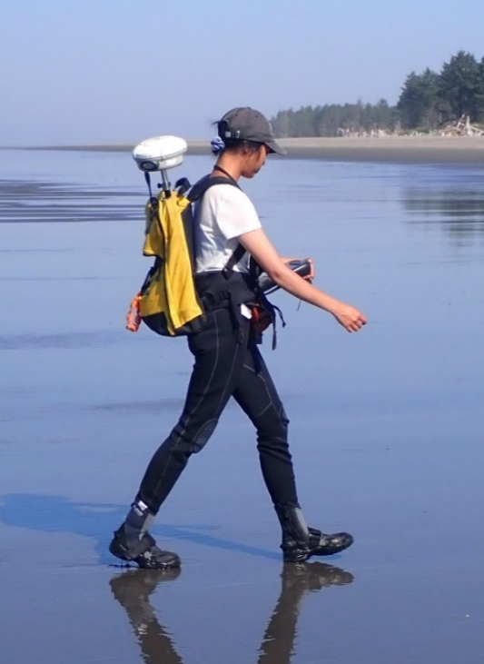
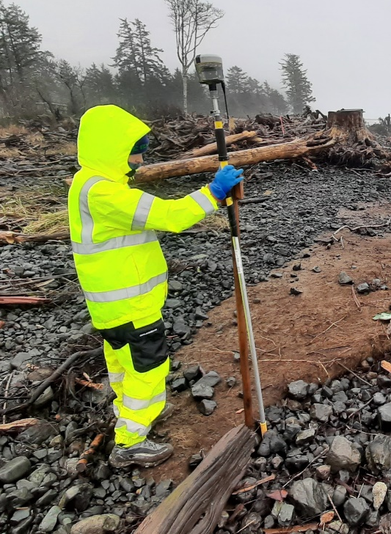
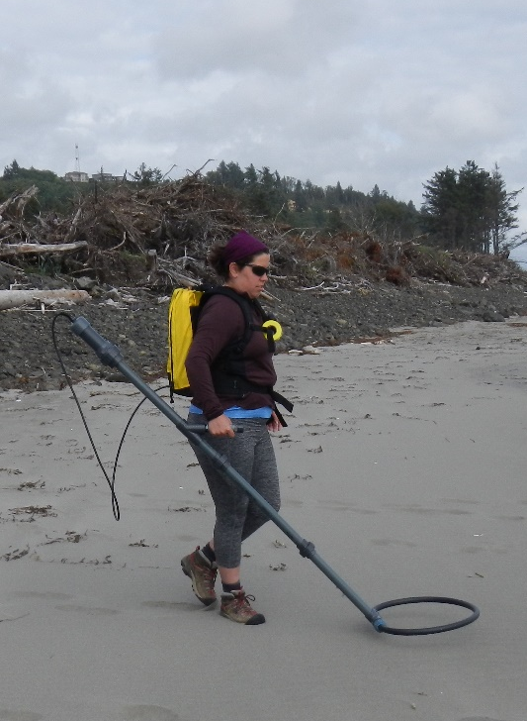
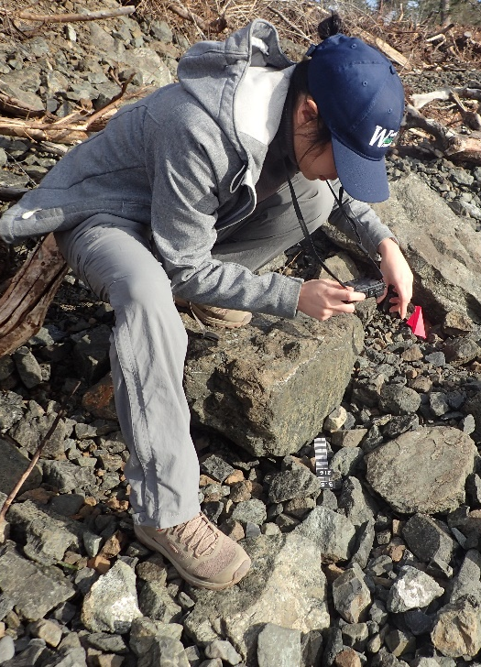
Monitoring Methods
Monitoring since 2018 including:
  Topographic surface mapping
  Topographic beach profiles
  Feature mapping
  RFID rock tracking
  Particle sizing
1
2
3
4
5

Slide 3
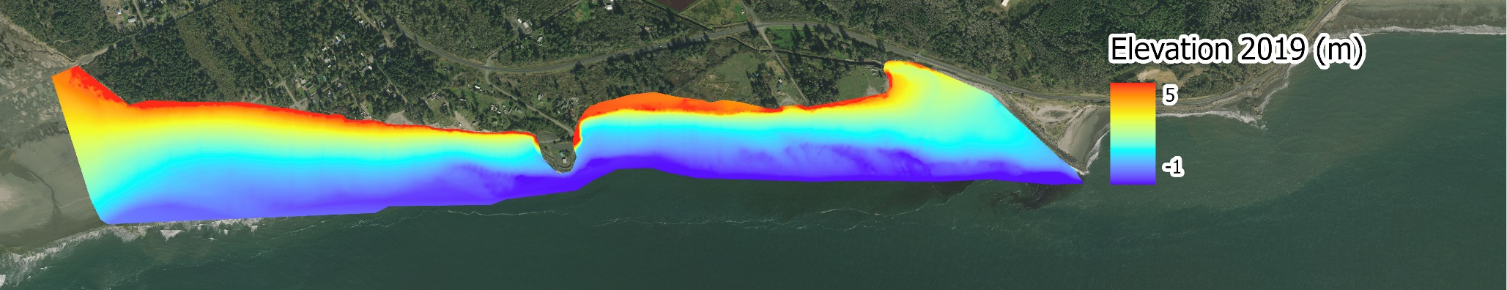
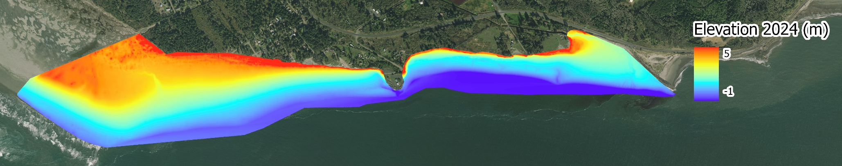
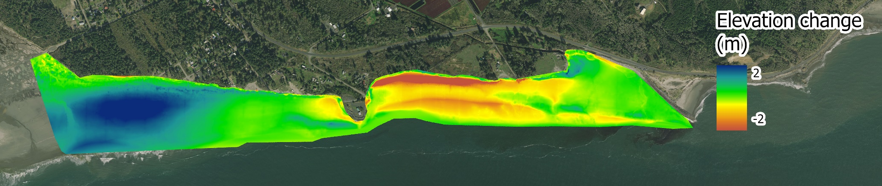
Surface Elevation Change in 5-years
Winter 2019
Winter 2024
5-years Change (2018 - 2023)
Net Sediment Deposition
295,596 Cubic Yards
5-years Change (2019 - 2024)
Image: NAIP 2021

Slide 4
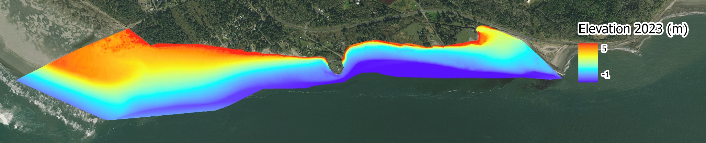
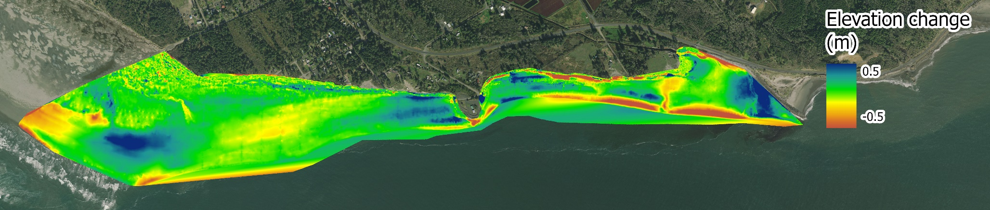
Change in Surface Elevation
Winter 2023
Winter 2024
Net Sediment Deposition
70,629 Cubic Yards
5-years Change (2018 - 2023)
1-year Change (2023 - 2024)
Image: NAIP 2021

Slide 5
Net Volume Change over 8.25 acres
Time | Net volume change (Cubic Yards) | Average elevation (m) | Average elevation (feet)
2019-2024 | 295,596 | 0.27 | 0.90
2023-2024 | 70,629 | 0.07 | 0.21

Slide 6
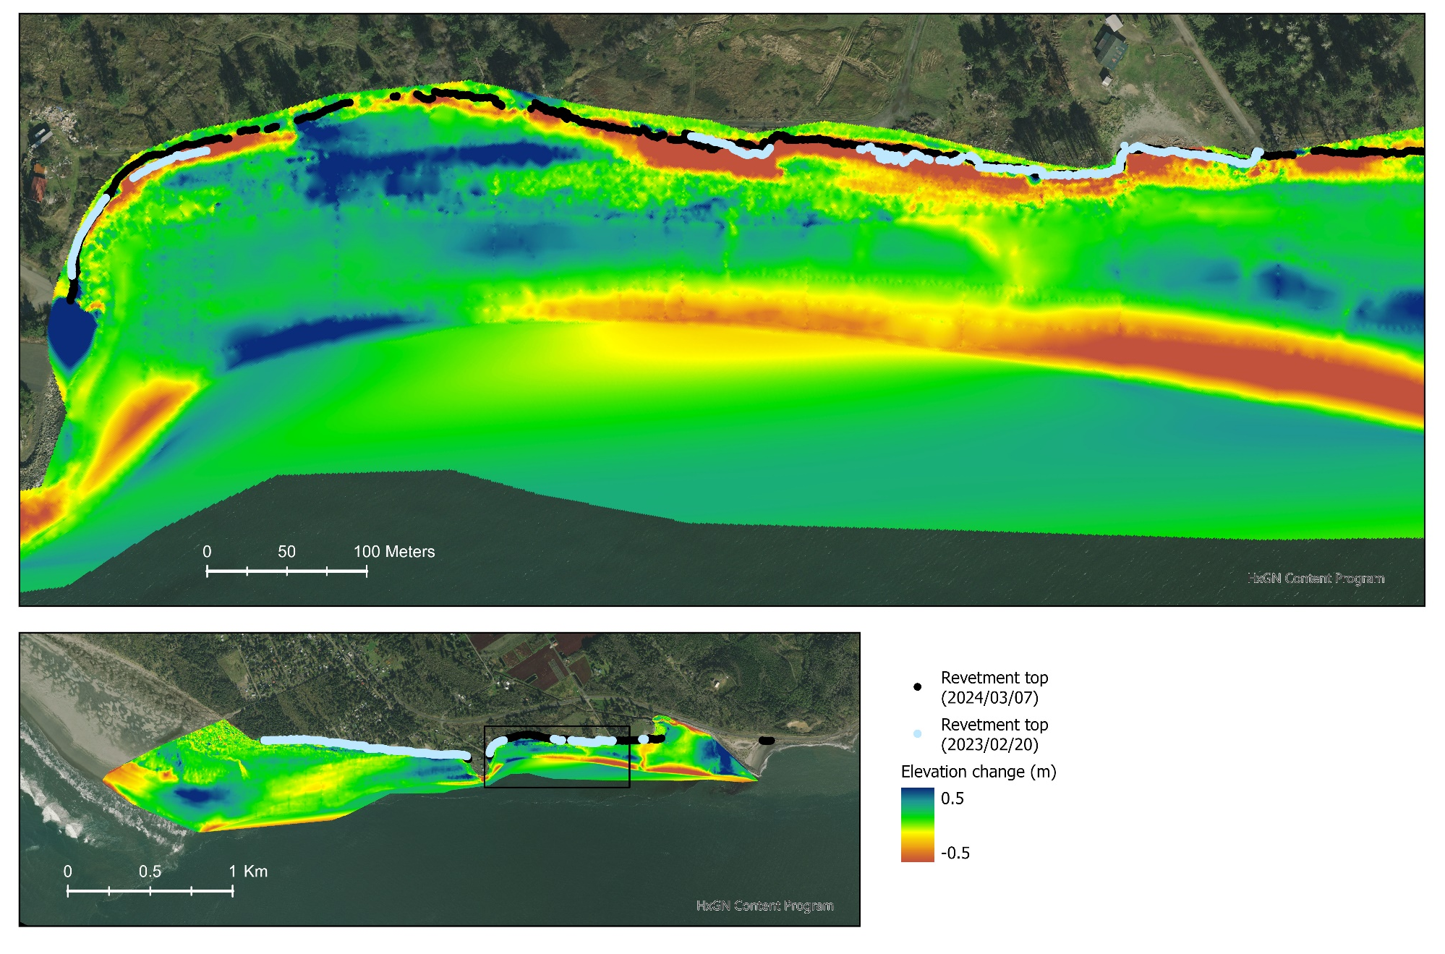
Change in Elevation from last winter
̴̴70 feet retreat
Image: NAIP 2021

Slide 7
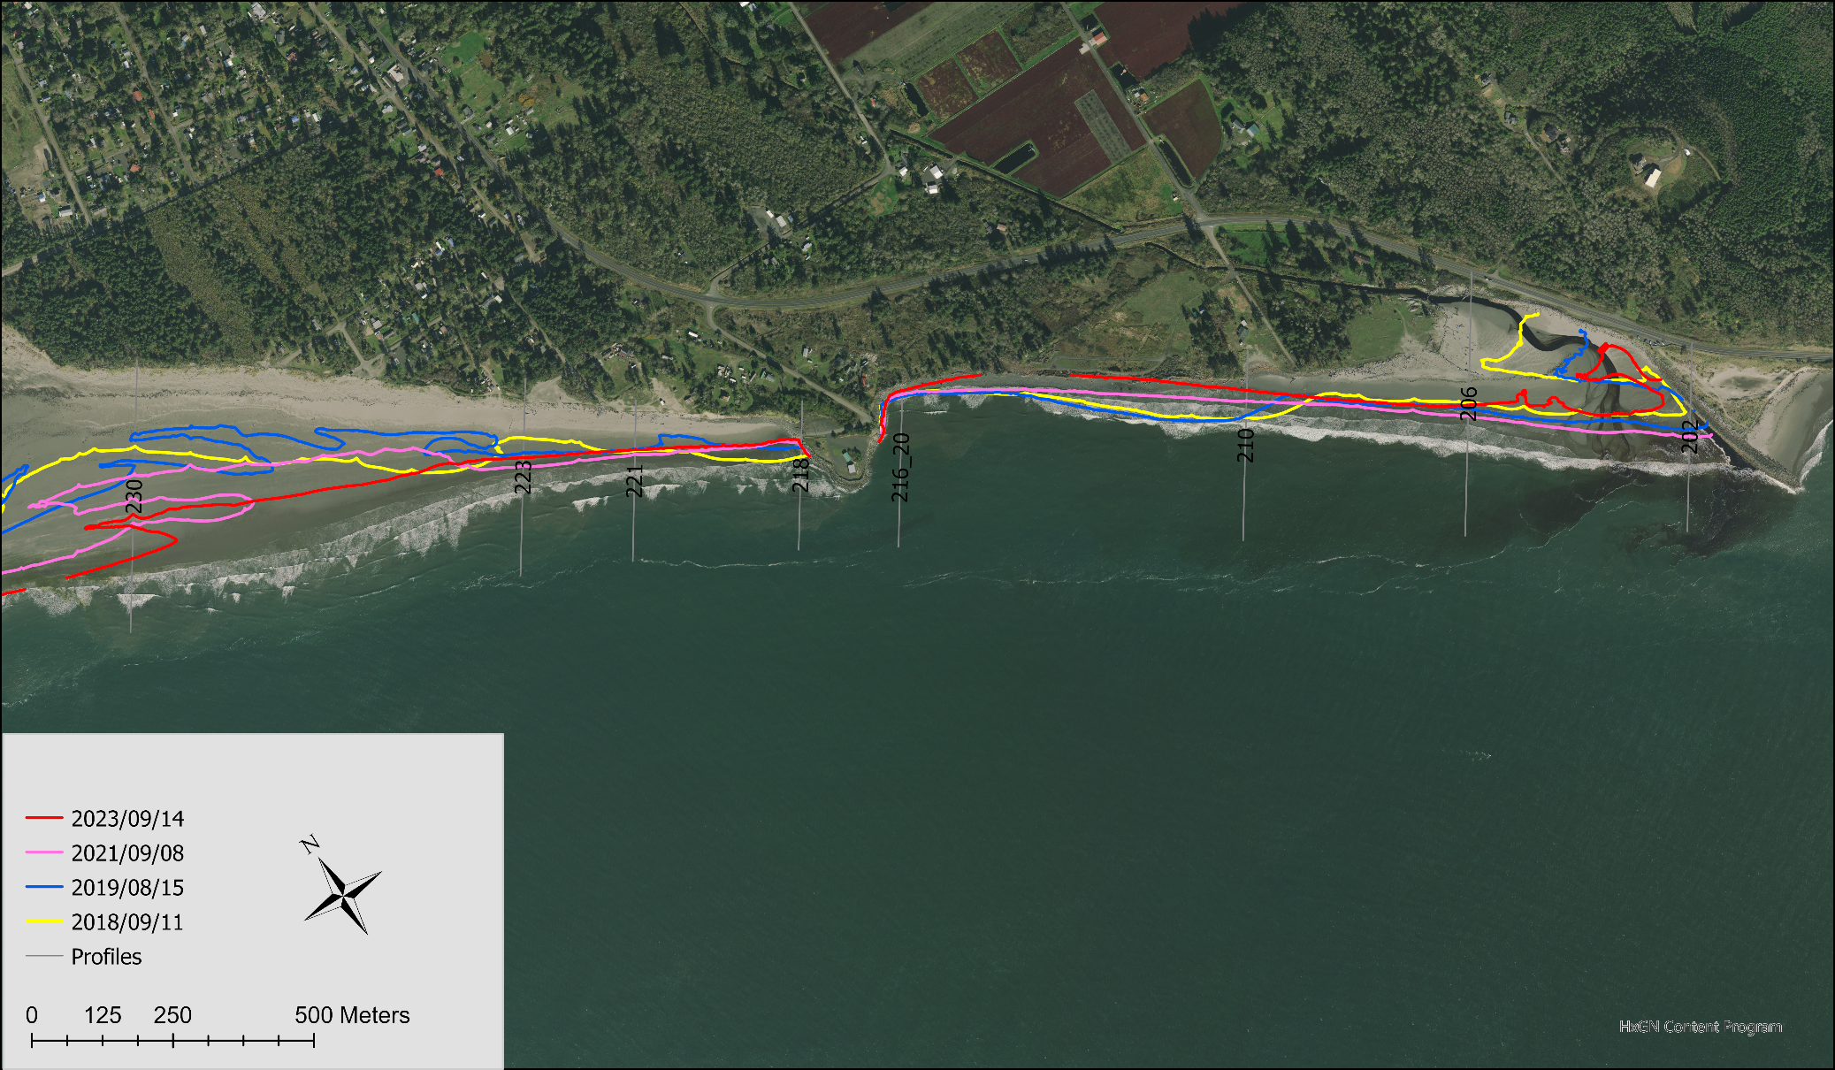
Performance Characteristics
Zone 4
Erosive Revetment
620 m
Zone 5
Dynamically Stable
400 m
Zone 6
Accreting
Spit
400 m
Zone 2
Dynamically Stable
200 m
Zone 3
Active
Revetment
300 m
Zone 1
Accreting Dunes + Beach
700 m
2 m NAVD 88 contour
Image: NAIP 2021

Slide 8
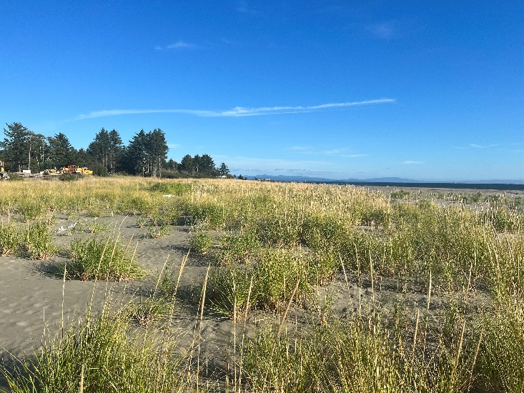
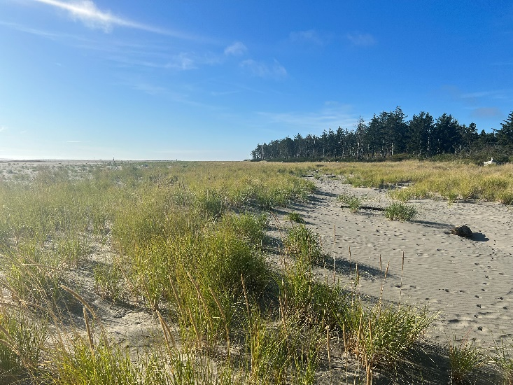
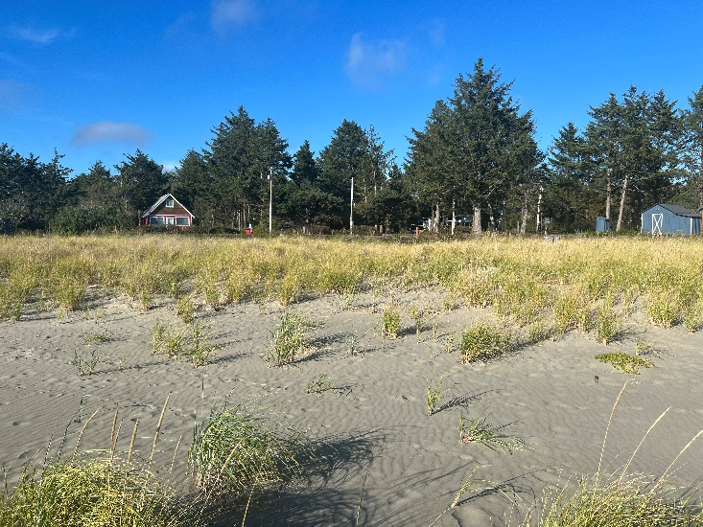
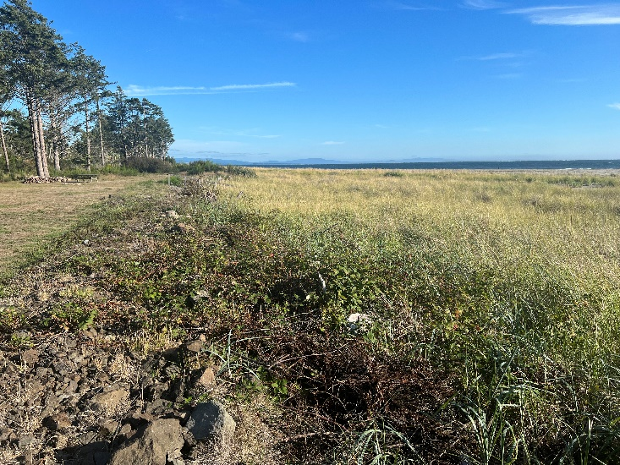
Zone 1: Dune Development
Observations
Stable, 700 m long dune
Mature dune grass (2 - 3 feet high)
Young dune grass (0 - 2 feet high)
Significant growth from 2018 - 2023
Minimum to no maintenance needed
Profile: 227: Looking east
Profile: 227: Looking west
Profile: 227: Looking landward
Profile 224: View from the top of dynamic revetment
Notes:
- Profile 230 to profile 223

Slide 9
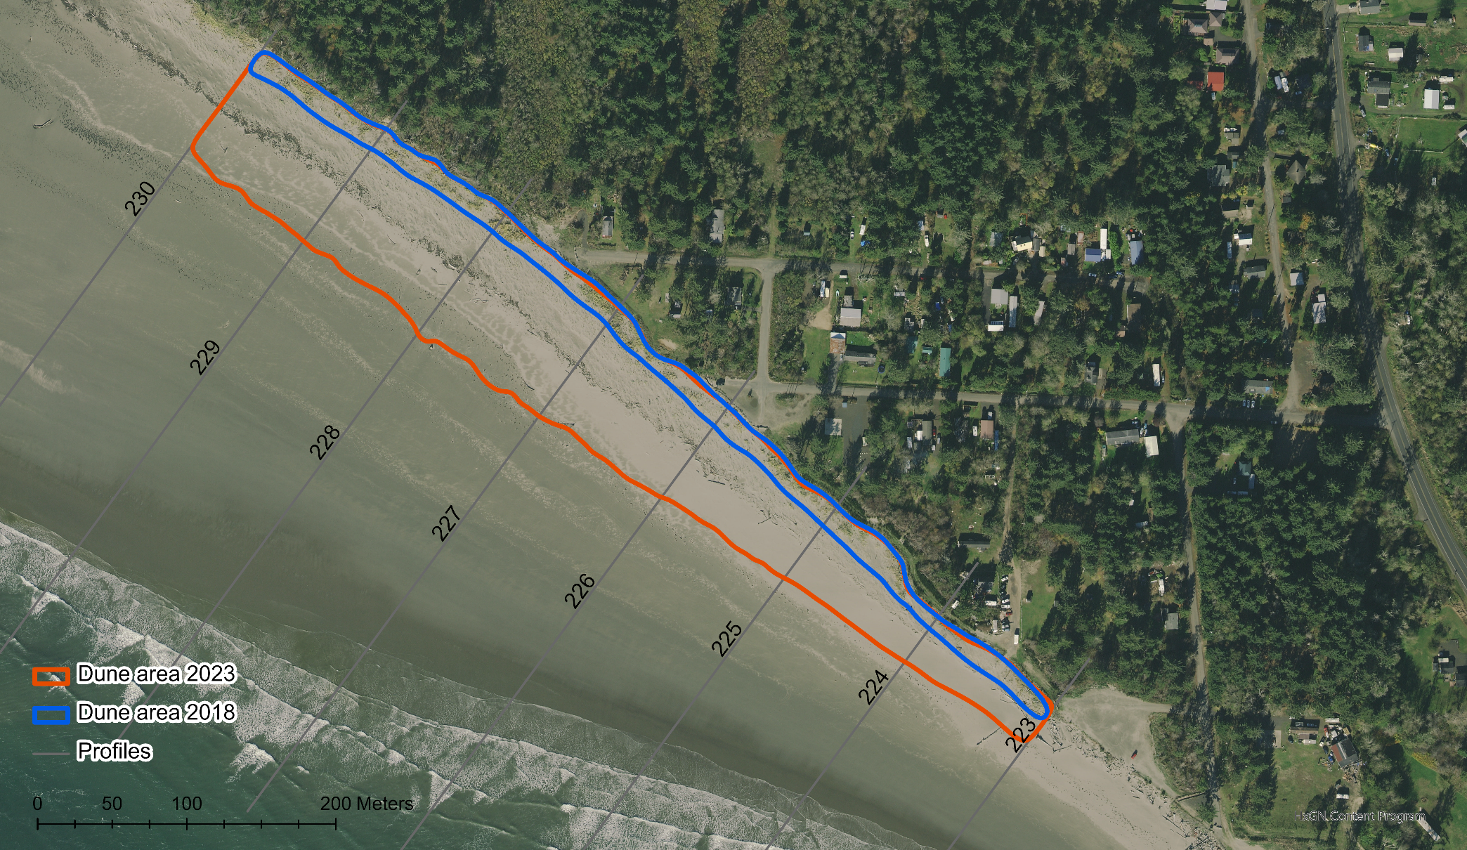
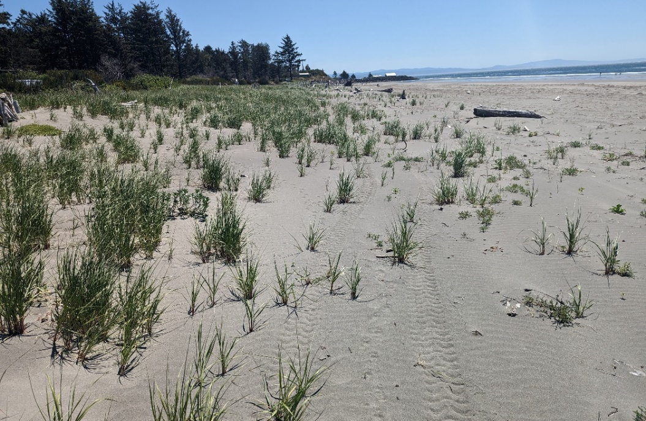
Zone 1: Dune Development
NAVD 88
Image: NAIP 2021

Slide 10
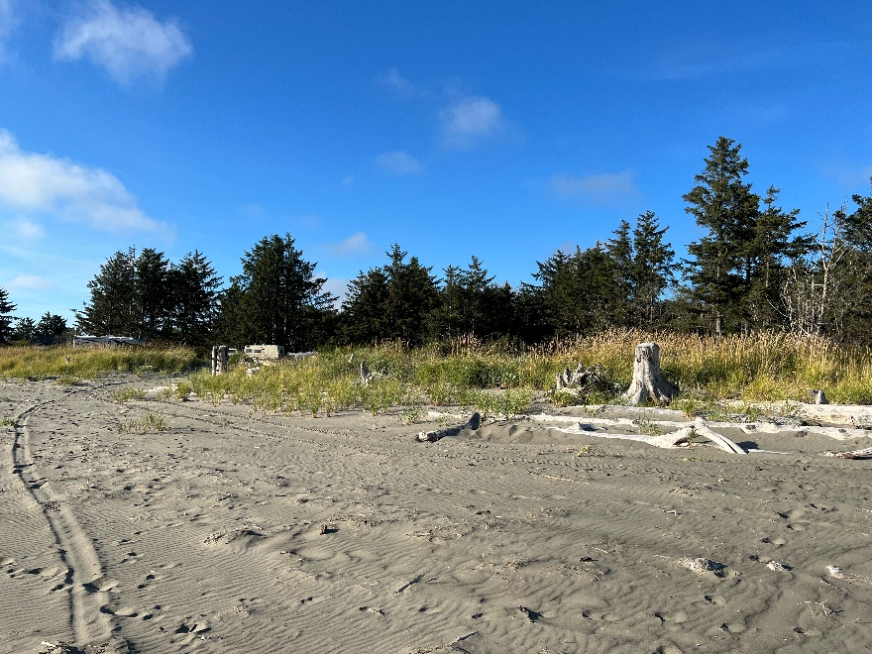
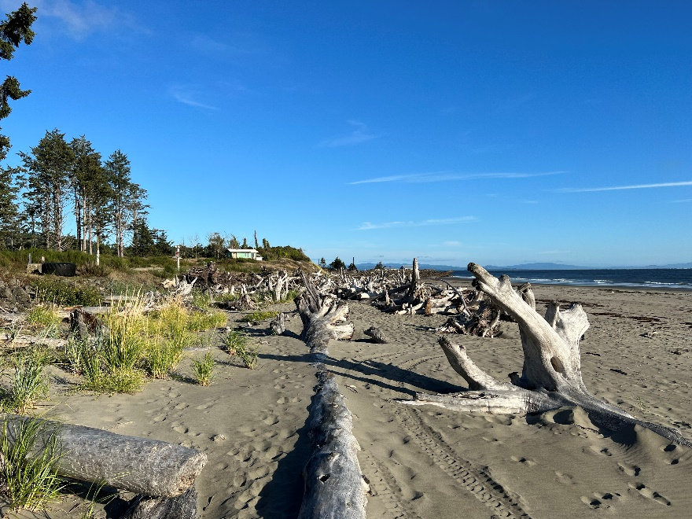
Zone 2: Dynamically Stable
Observations
200 m long dynamically stable area
Eddy current dominates hydrodynamics
Depositional zone for large wood ~20-30 feet long and 3 feet diameter stem
Narrow backshore zone of dune grass in western half
Transition to stable dune
Profile 223 to 222: large wood + dune grass
Profile: 227: Looking east
Profile: 227: Looking west
Profile: 227: Looking landward
Profile 224: View from the top of dynamic revetment
Profile 222 to 221: large wood only

Slide 11
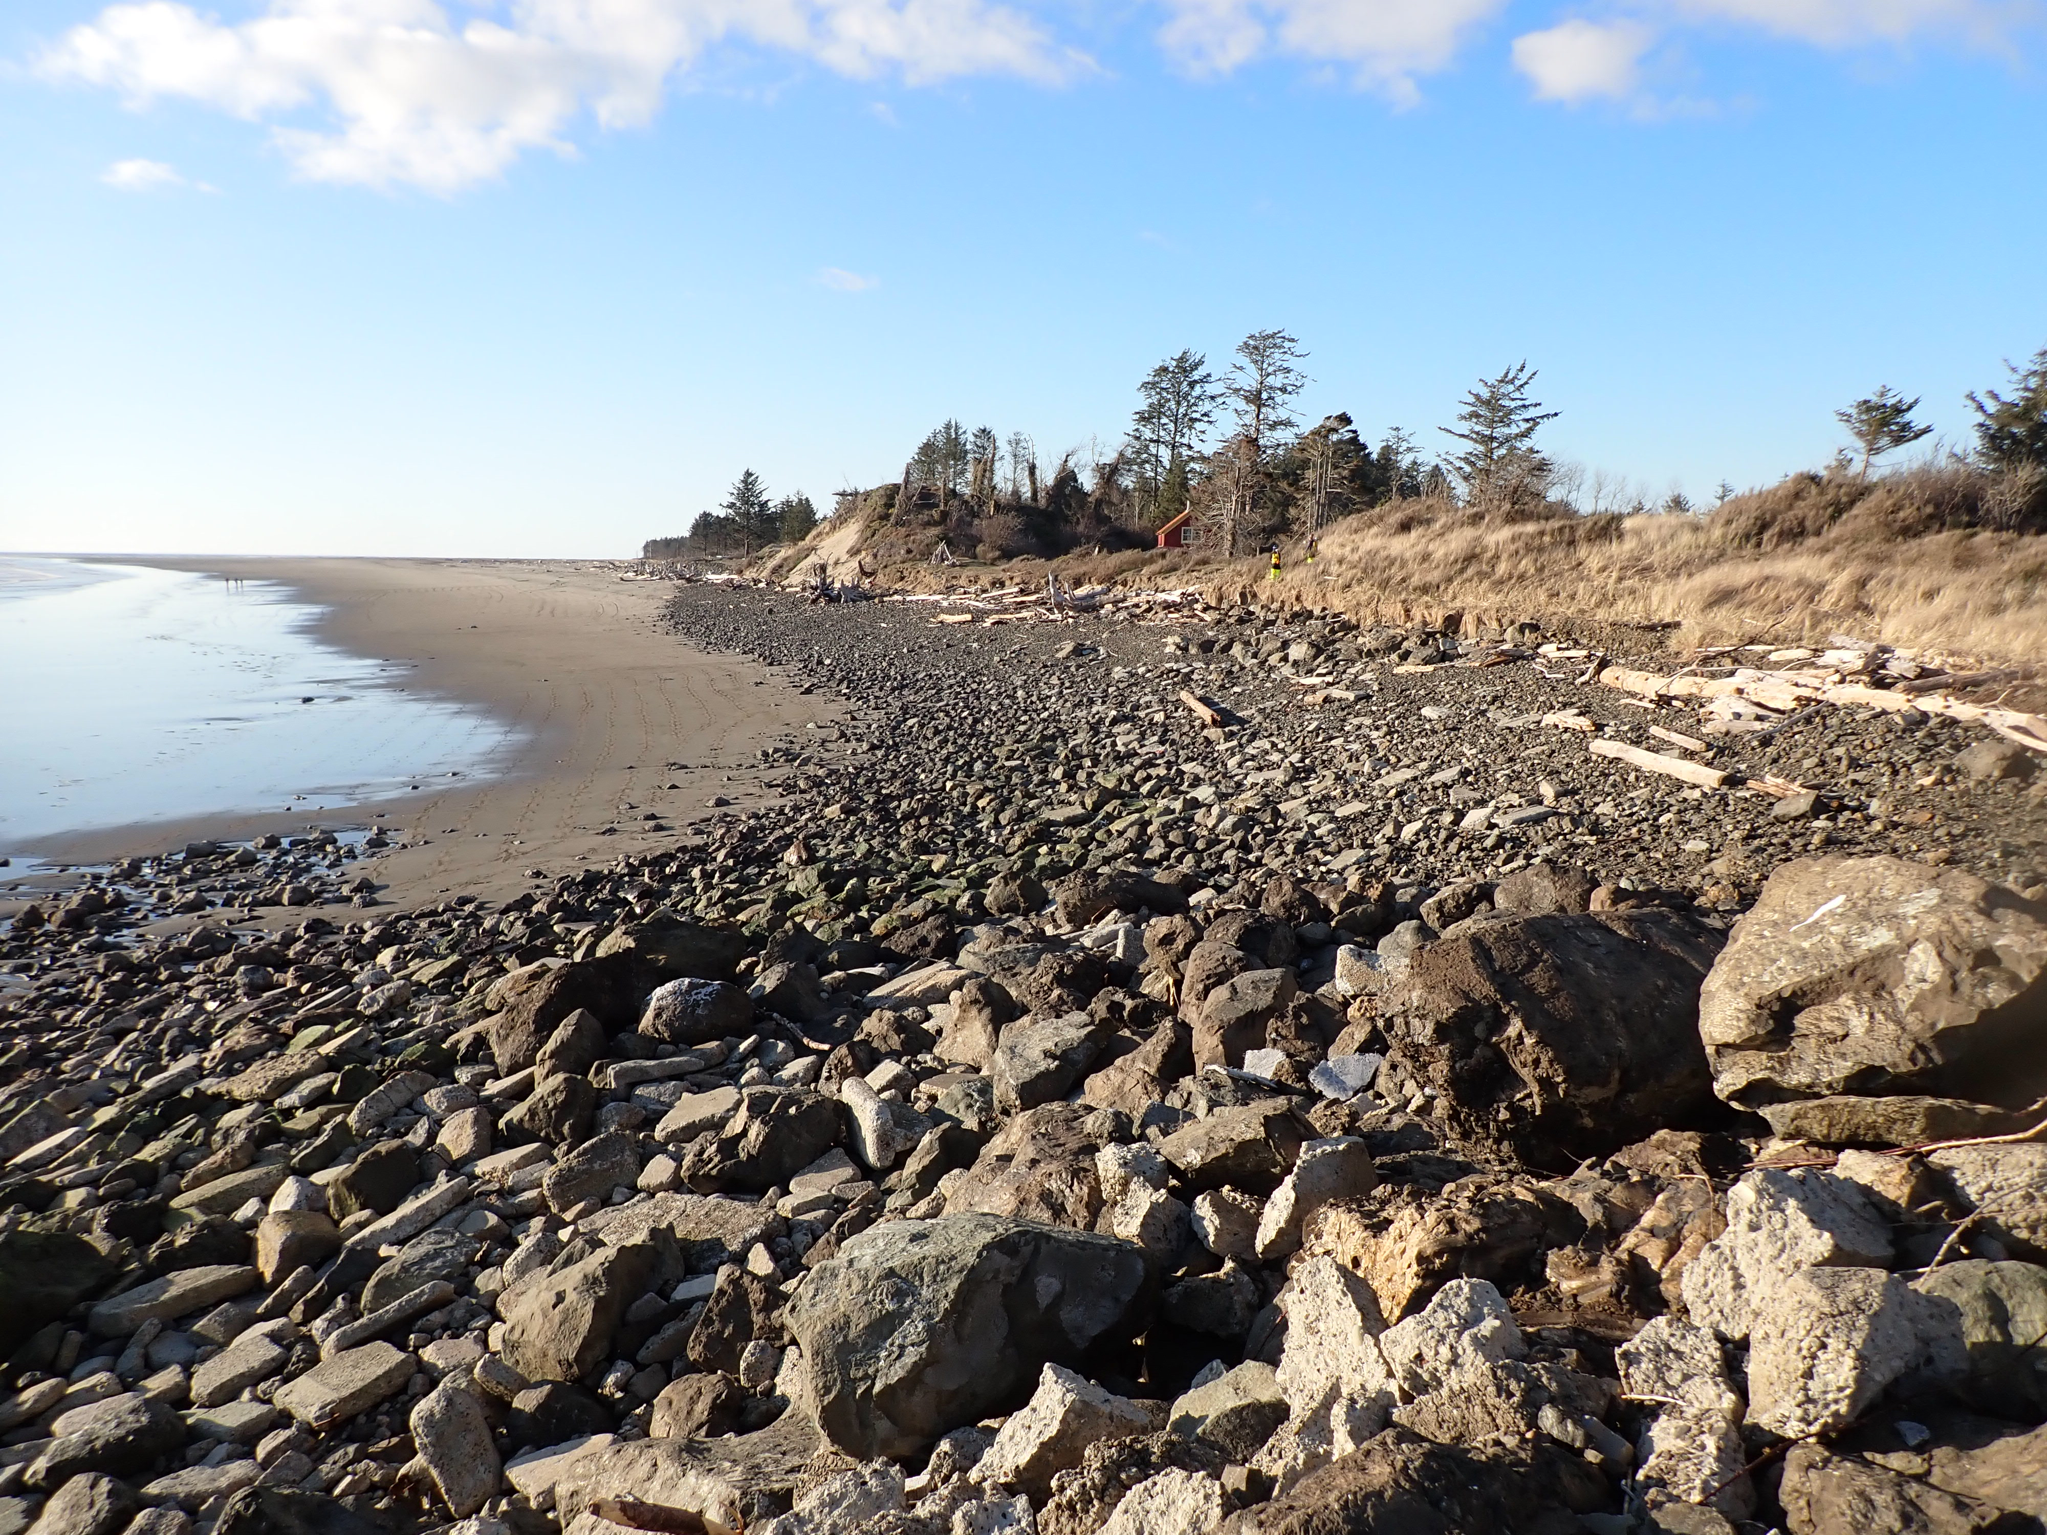
Zone 3: Active Revetment

Slide 12
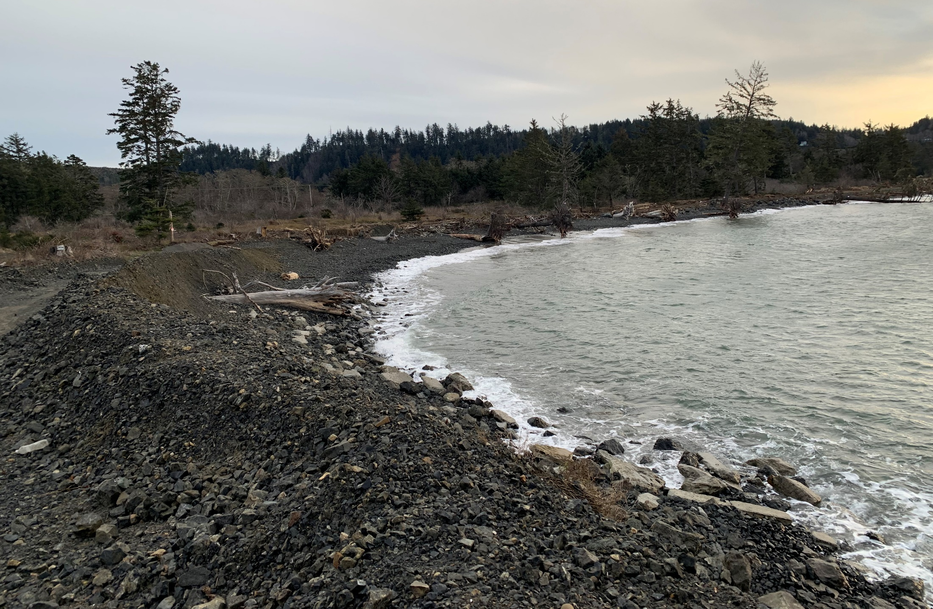
Zone 4: Erosive Revetment

Slide 13
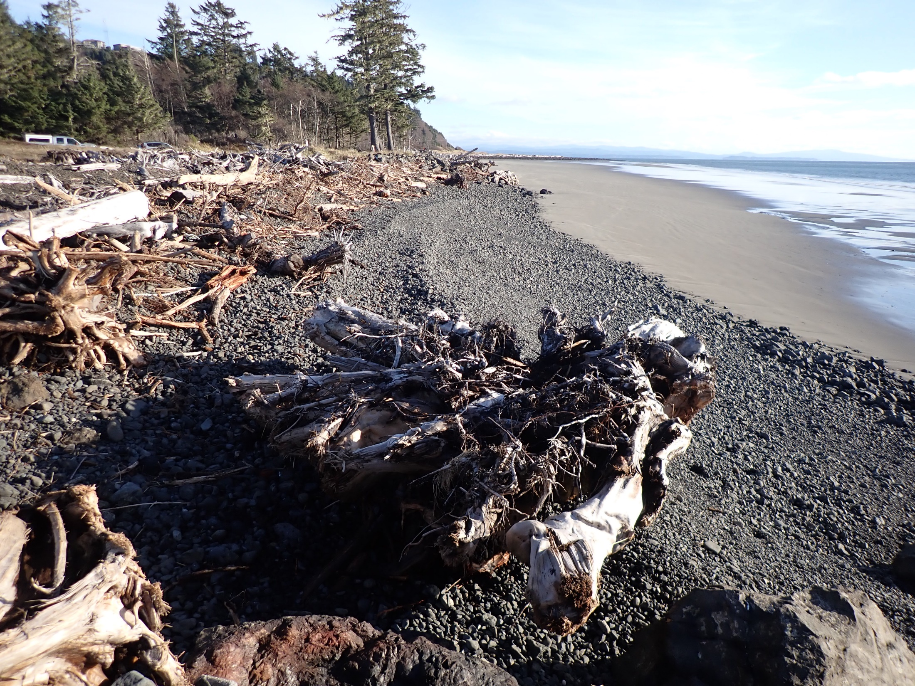
Zone 5: Dynamically Stable

Slide 14
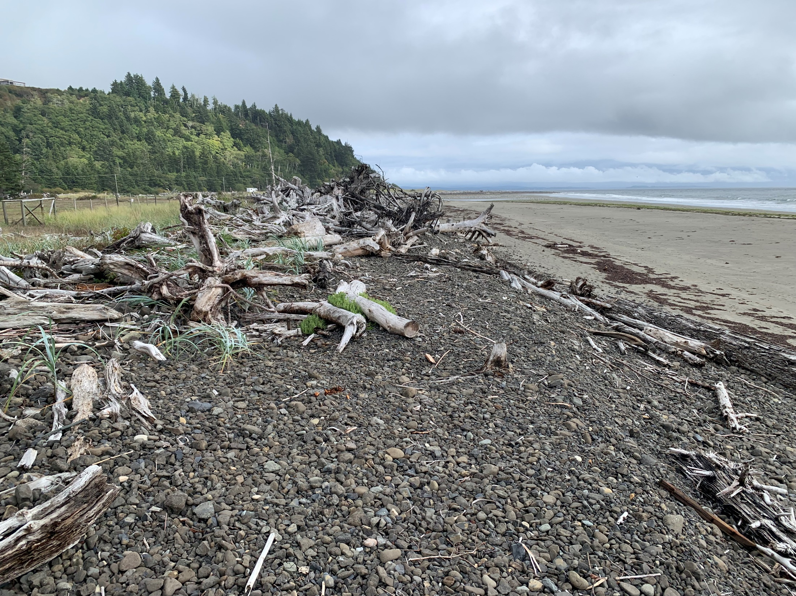
Zone 5: Cobble Berm Development

Slide 15
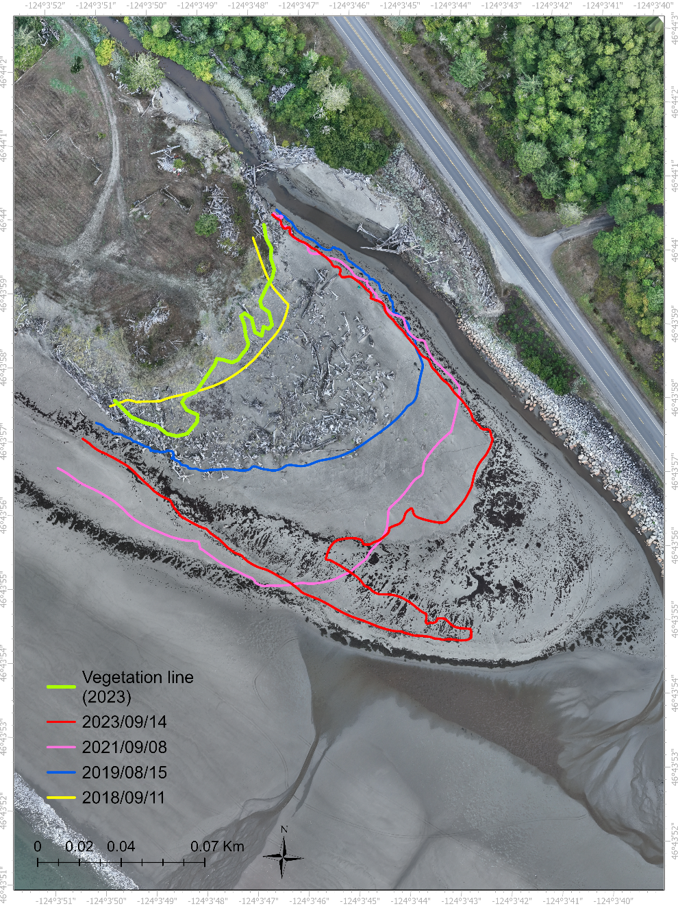
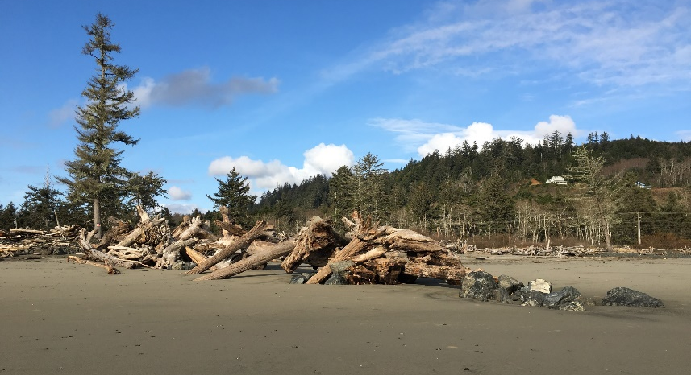
Zone 6: Spit Growth
Spit Growth
Year | Length from 2023 vegetation line (m)
2018 | 4
2019 | 63.5
2021 | 88.8
2023 | 109.4
3m contour
Image: Ecology 2023

Slide 16
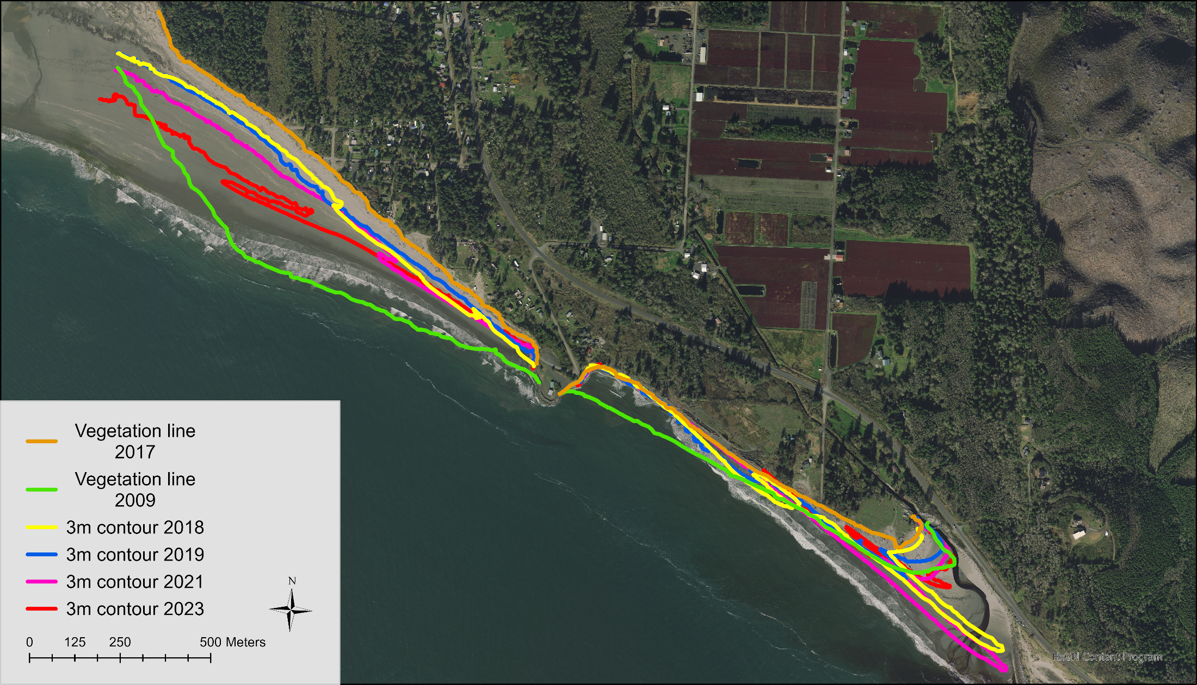
Conceptual Model
Managed advance,
dune growth
Headland feeder bluff
Sediment supply
Managed retreat
Sediment bypassing
Spit growth
Cobble berm growth

Slide 17
Conclusions
A modest-scale 2.2 km long quarry spall cobble dynamic revetment and complementary large wood features have halted a rapidly retreating shoreline
Results range from managed advance with developing dunes, high sediment supply, large wood recruitment and dune grass to managed retreat with low sediment supply, low elevation, narrow beach and high cobble transport
Ongoing adaptive management, especially the replenishment of cobble at point sources and increasing upland elevation is essential for maintaining dynamic stability
Ongoing monitoring is essential for informing adaptative management and testing nature-based measures

Slide 18
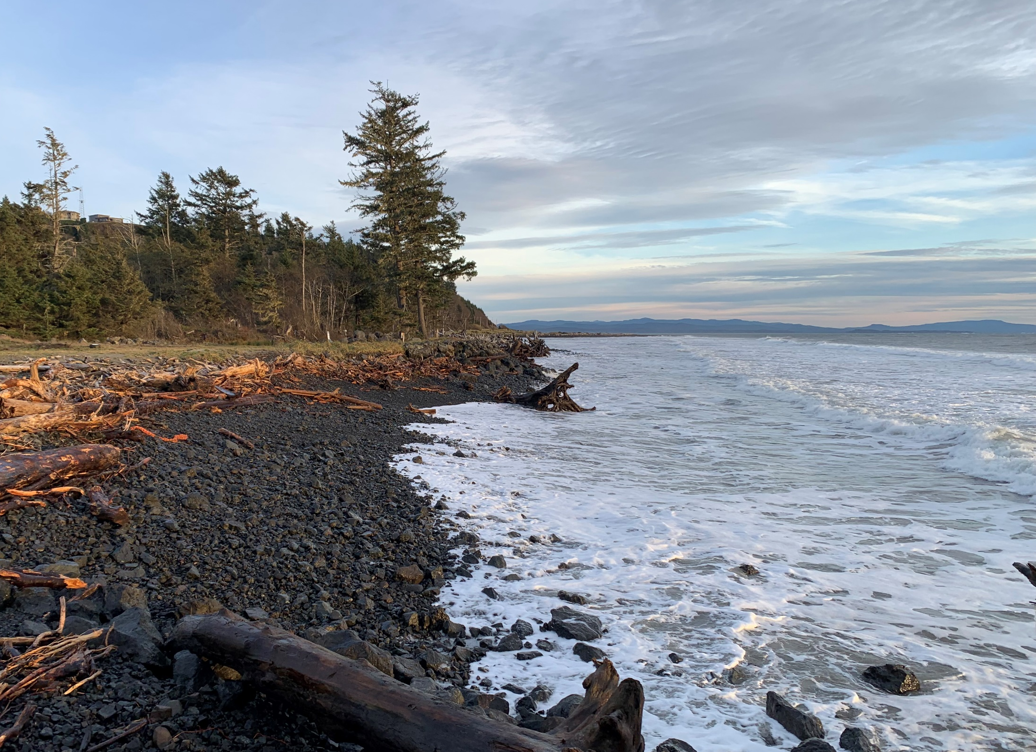
Thank you
George Kaminsky
gkam461@ecy.wa.gov
David Cottrell, Pacific Drainage District #1
Pacific Conservation District
Pacific County
Mott MacDonald
Dave Michalsen, Seattle District U.S. Army Corps of Engineers
Connie Allen, WashAway No More
Shoalwater Bay Tribe
Northwest Association of Networked Ocean Observing Systems (NANOOS)
Paul Bayle, Chris Blenkinsopp, University of Bath
NOAA Office for Coastal Management
Moffatt & Nichol
Washington Department of Ecology Coastal Monitoring & Analysis Program team: Heather Weiner, Diana McCandless, Gabby Alampay, Michelle Gostic, Delaney Stokes, Casey Madill, Kennadie Selden, Alena Reynolds, Alice Henderson

Slide 19

ADA Accessibility
The Department of Ecology is committed to providing people with disabilities access to information and services by meeting or exceeding the requirements of the Americans with Disabilities Act (ADA), Section 504 and 508 of the Rehabilitation Act, and Washington State Policy #188.
To request an ADA accommodation, contact Ecology by phone at 360-407-6831 or email at ecyadacoordinator@ecy.wa.gov. For Washington Relay Service or TTY call 711 or 877-833-6341. Visit Ecology’s website for more information.

