Slide 1
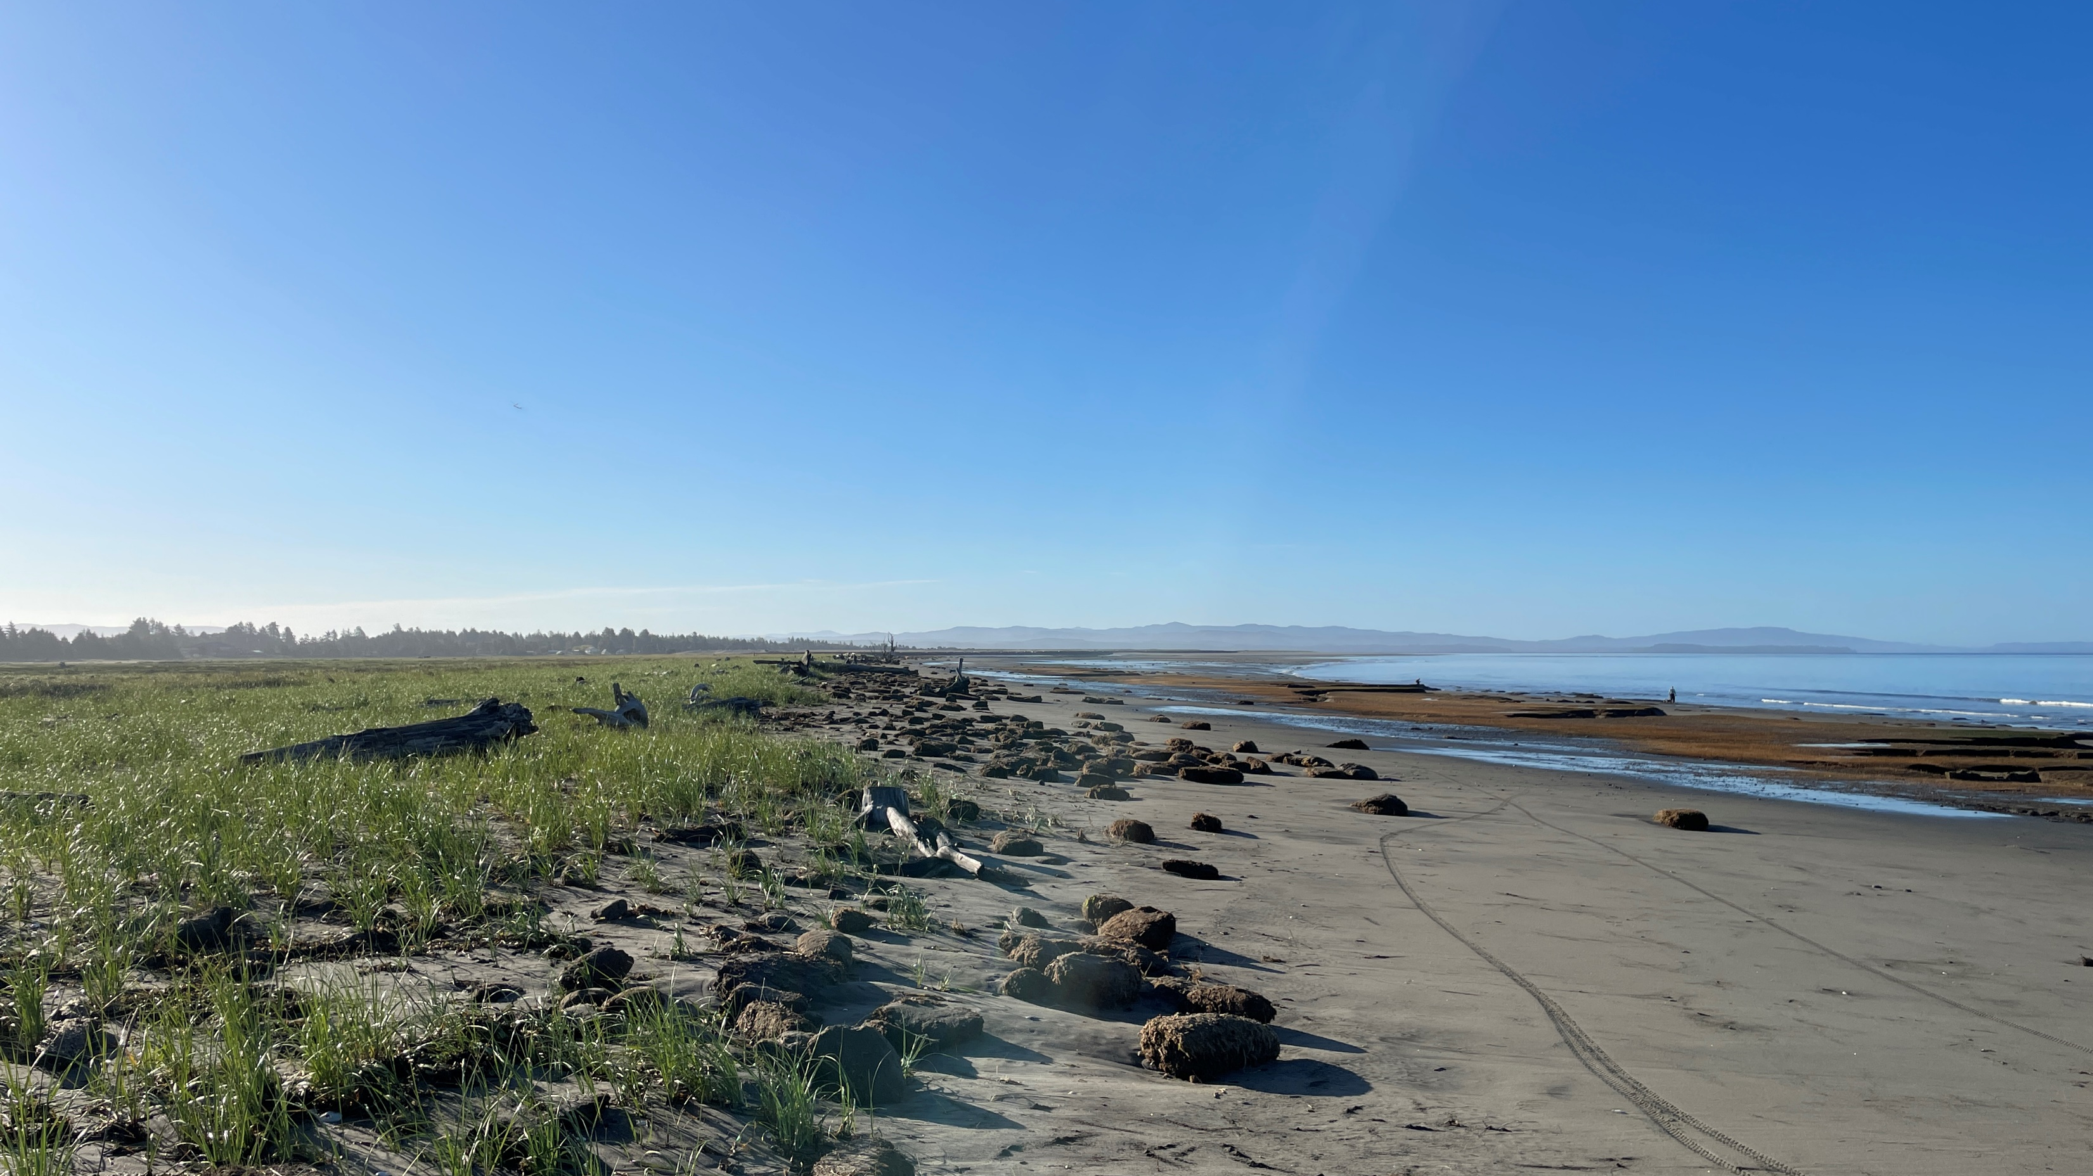
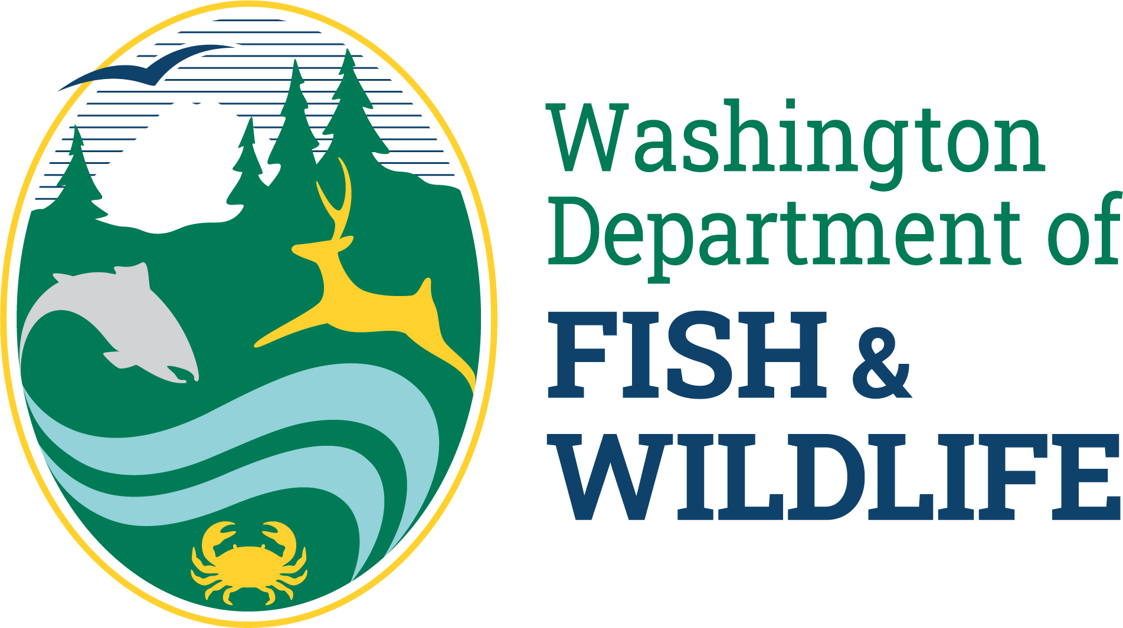
Coastal cobble beach revetments
WECAN update
August 13 2024
Wendel Raymond
WDFW | Habitat Program

Slide 2
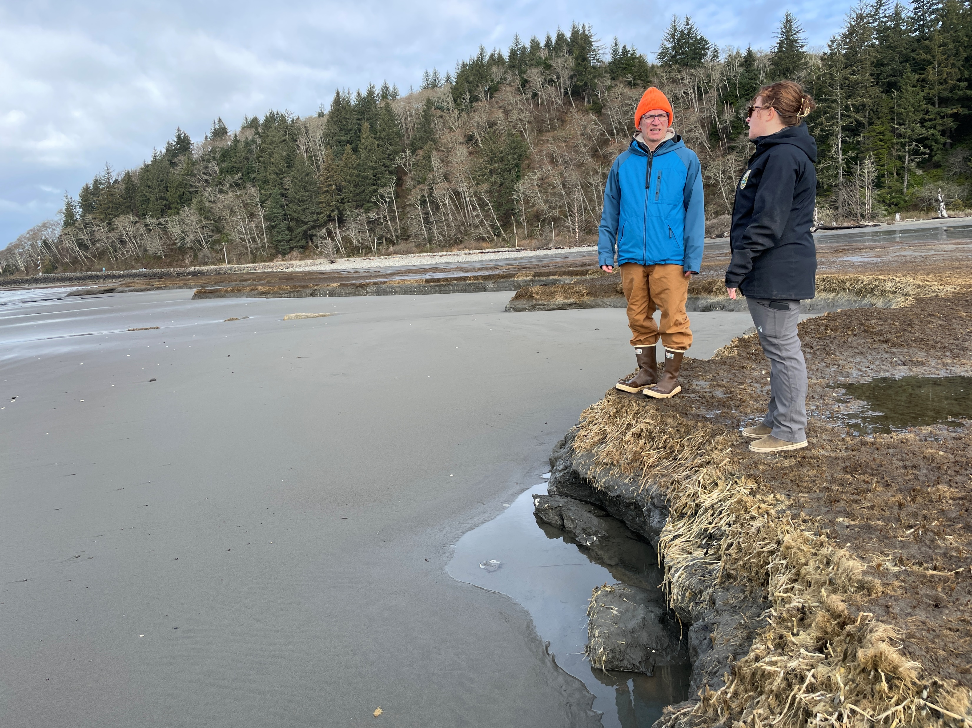
Big question: What are the ecological effects of cobble beach revetments on coastal beaches?
Describe ecological patterns at Graveyard Spit and reference sites before and after revetment construction.
Identify key ecological metrics affected by revetment to frame mitigation strategies for future projects.
Coordinate and collaborate with current project leads, WSDOT, ECY, and Shoalwater Bay Tribe to increase understanding across agencies.

Slide 3
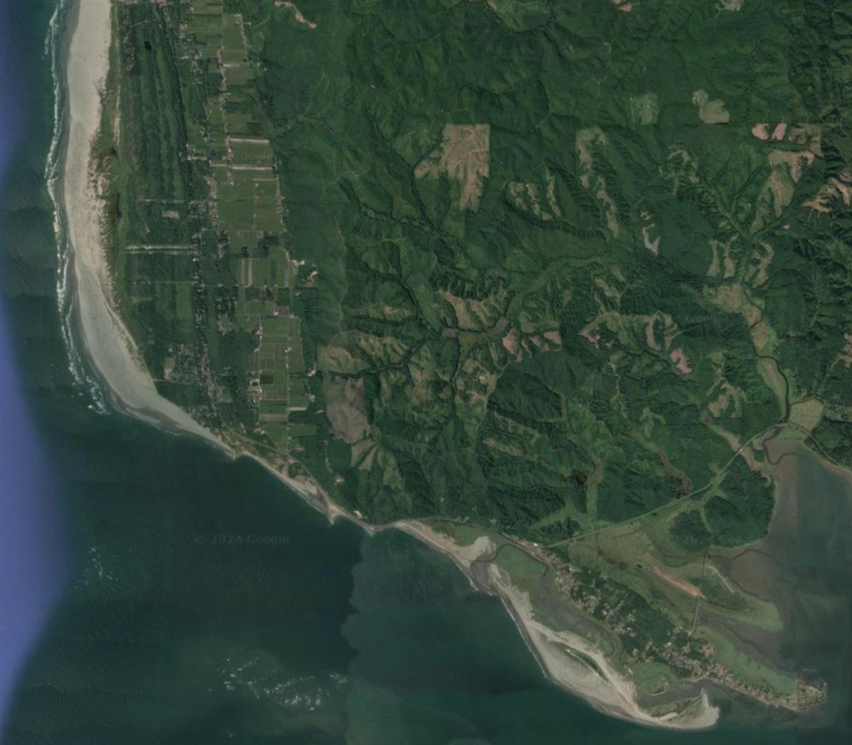
Sampling locations
Graveyard spit – new revetment
North Cove – old revetment
Grayland Beach – Natural beach
Approach allows for a before/after – control/impact comparison
Grayland Beach
North Cove
Graveyard Spit
Tokeland

Slide 4
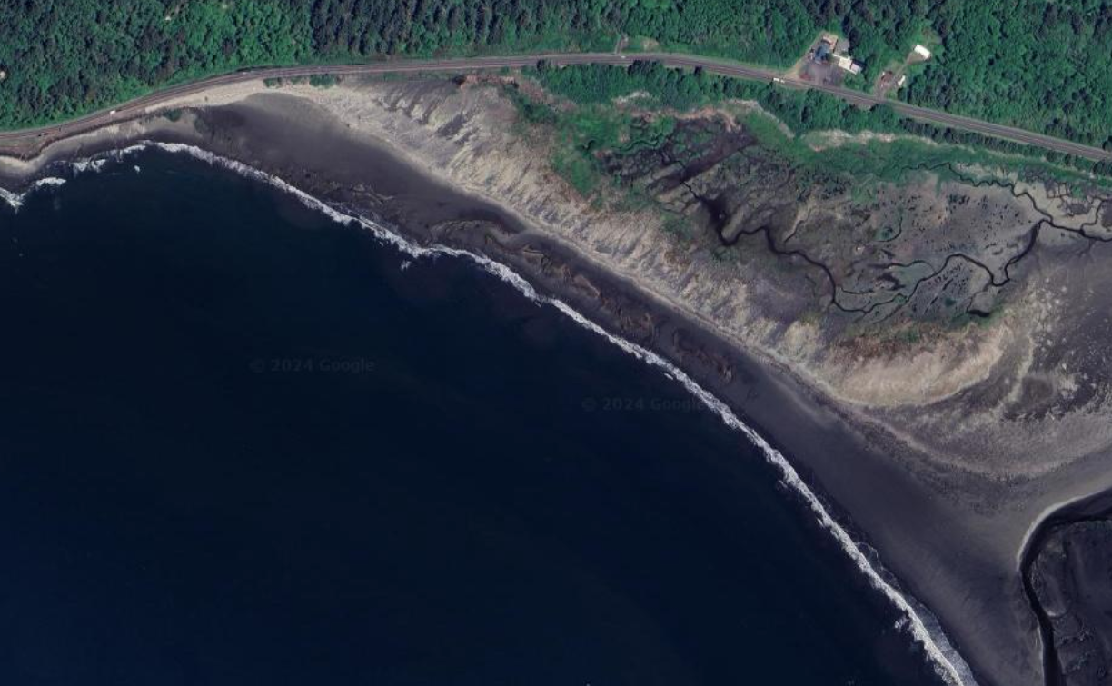
What? How?
Beach wrack line metrics
Wrack composition/deposition
Wrack invertebrates
Log line
Sediment type
Benthic invertebrates
Clams and worms
Beach profiles
Slope perpendicular to water
100m transect
~1 km

